Slide 1
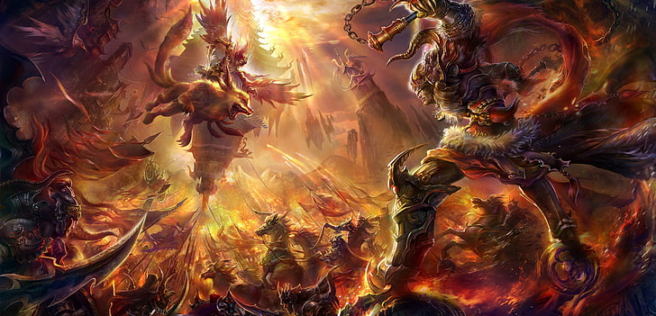
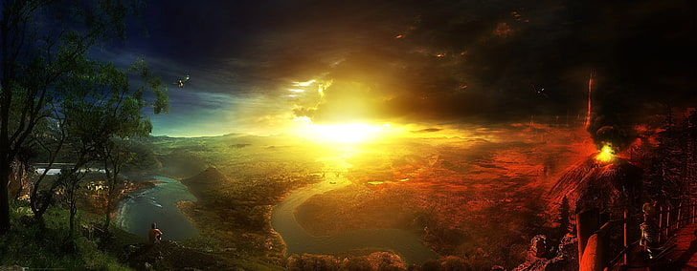
Destiny’s Calling
-A WORLD UNITED
Kenneth D. Johnson II
Developing New Worlds:
Environment and Historical Research Online
Fullsail University
30 May 2025
Kimberly Borwick, Instructing

Slide 2
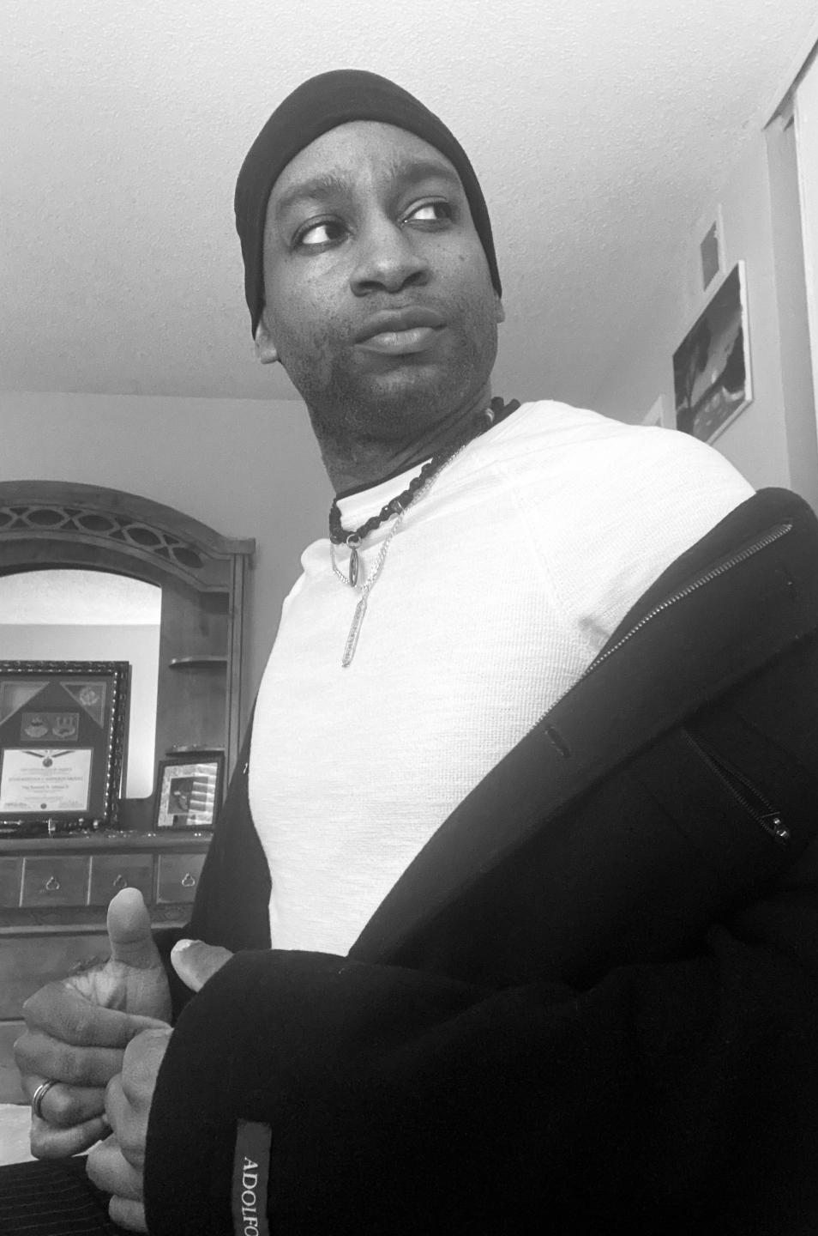

Story Premise
In the wake of post-military depression, KJ/Sargeant Johnson finds himself and family amid another spiritual conflict. The enemy (Dark One) has found a way to infuse his malice and evil on to the contemporary world, and now KJ must lead a spiritually anointed and empowered group against the Dark One and his foes, with the world's government uniting behind him, while still balancing his faith and his purpose to stop the enemy from overpowering the earth with evil and destroying all harmony and peace that exists.

Slide 3
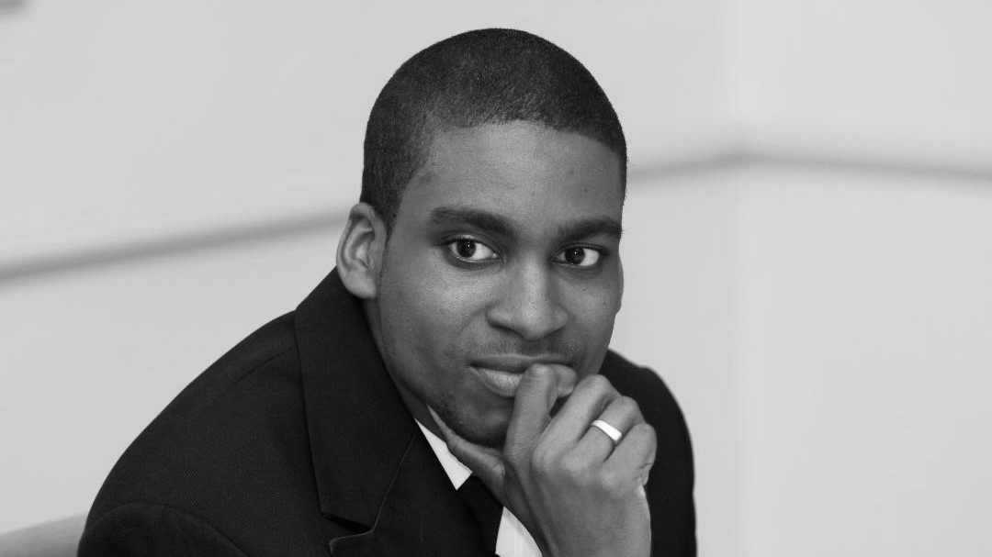
Historical
Background
KJ’s early years in life were no picnic. He was born as a military brat where both his parents were enlisted in the United States Air Force. As time would move on he would leave the east coast with his mother leaving his father behind with the choices he had made. Now being a single mother and in a time where things were getting rough cam much turmoil and many challenges to her health as well as her mind.
The first conflict would occur shortly after KJ’s entrance into junior high where he and close friends would get empowered and strengthened by a spirit in order to combat low-level threats that endangered the small community. Once the enemy was neutralized things became even worse in the house and his mother, the Heavenly Messenger meant to guide her new Chosen One son, was removed from her spiritual position-and was given over to another woman who would be his new mother, whose family he would join. This caused much malice between KJ and his biological mother, so much that she turned on him, tried to kill him at some point, but then risked her second life to save his and was caught up in forgiveness and glory before the Lord. All of this would occur as they encountered three total conflicts-all spawn from Satan’s hands.

Slide 4
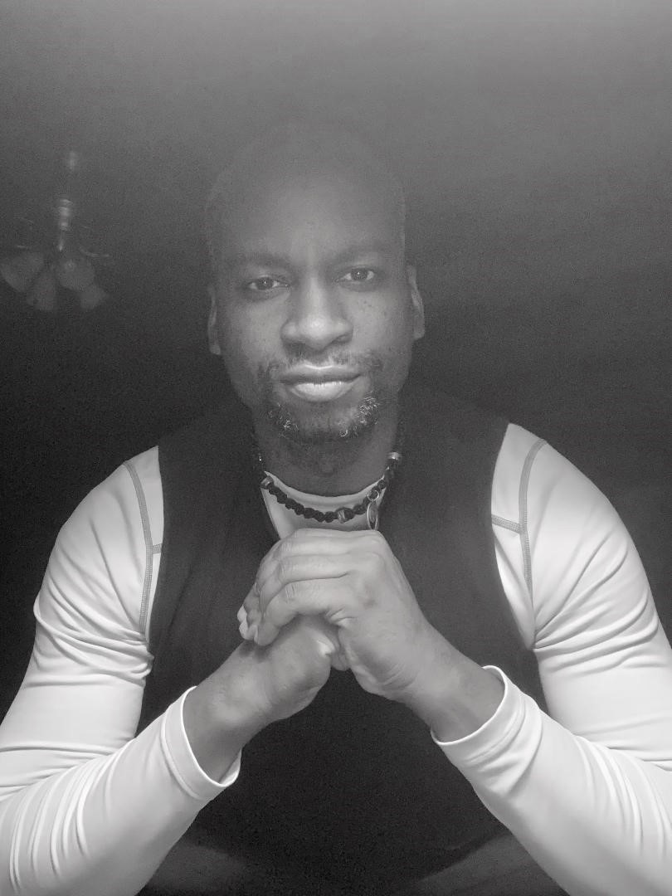
Historical
Background
After the last conflict, KJ began to take solace in peace and moved on to continue his own career in the Air Force where he would then retire after twenty total years. During this time his powers would diminish and his focus on said position would become an afterthought. For years, without the whole world being aware, he was the young man who was chosen to defeat the enemies armies of evildoers and then he also found his identity in his loyalty to the military. Once both seemed to be gone, he was at a place of little hope, and little direction.

Slide 5
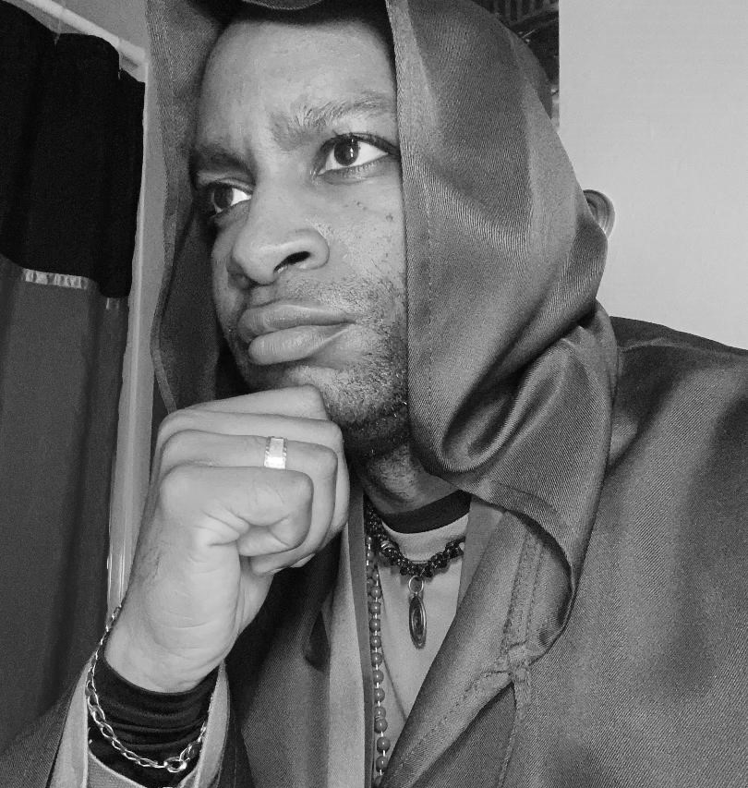
The main character is the “Chosen One” who is anointed with power from God via the Angel of the Lord and the Heavenly Messenger and is responsible for leading the united world against the evil demonic spirits and leaders who wish to cause nothing but confusion, destruction, and death. Even in all this, the main character is still human, struggling with post-military depression, and partially broken due to unhealed trauma working to take his mind over.
Main Character Biography

Slide 6
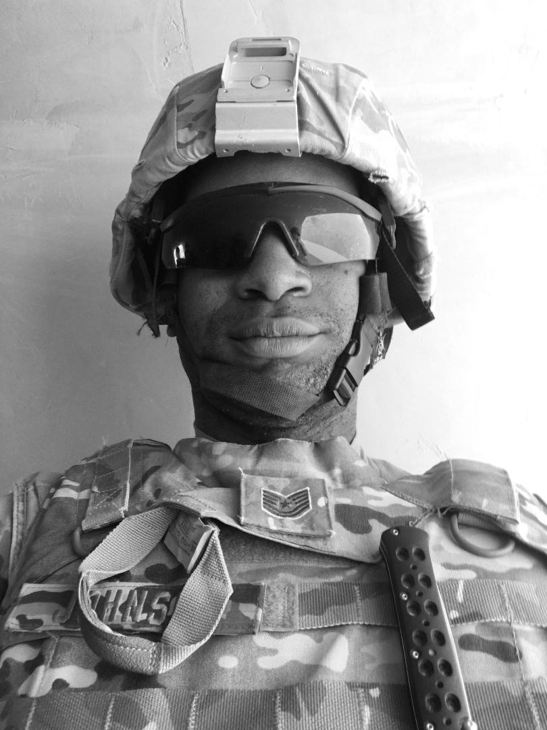
Main Character Biography
• Character name: Sargeant Johnson
• Nickname: KJ
• Origin of Nickname: Biological father name is Kenneth Johnson I/wants no confusion between him and his father
• Birthdate: 12-16-82
• Place of Birth: Dover, DE, Air Force Base
• Age at beginning of story: 39
• Ethnicity: African-American
• Which Religion: Christian
Height: 6”1
• Weight: 178

Slide 7
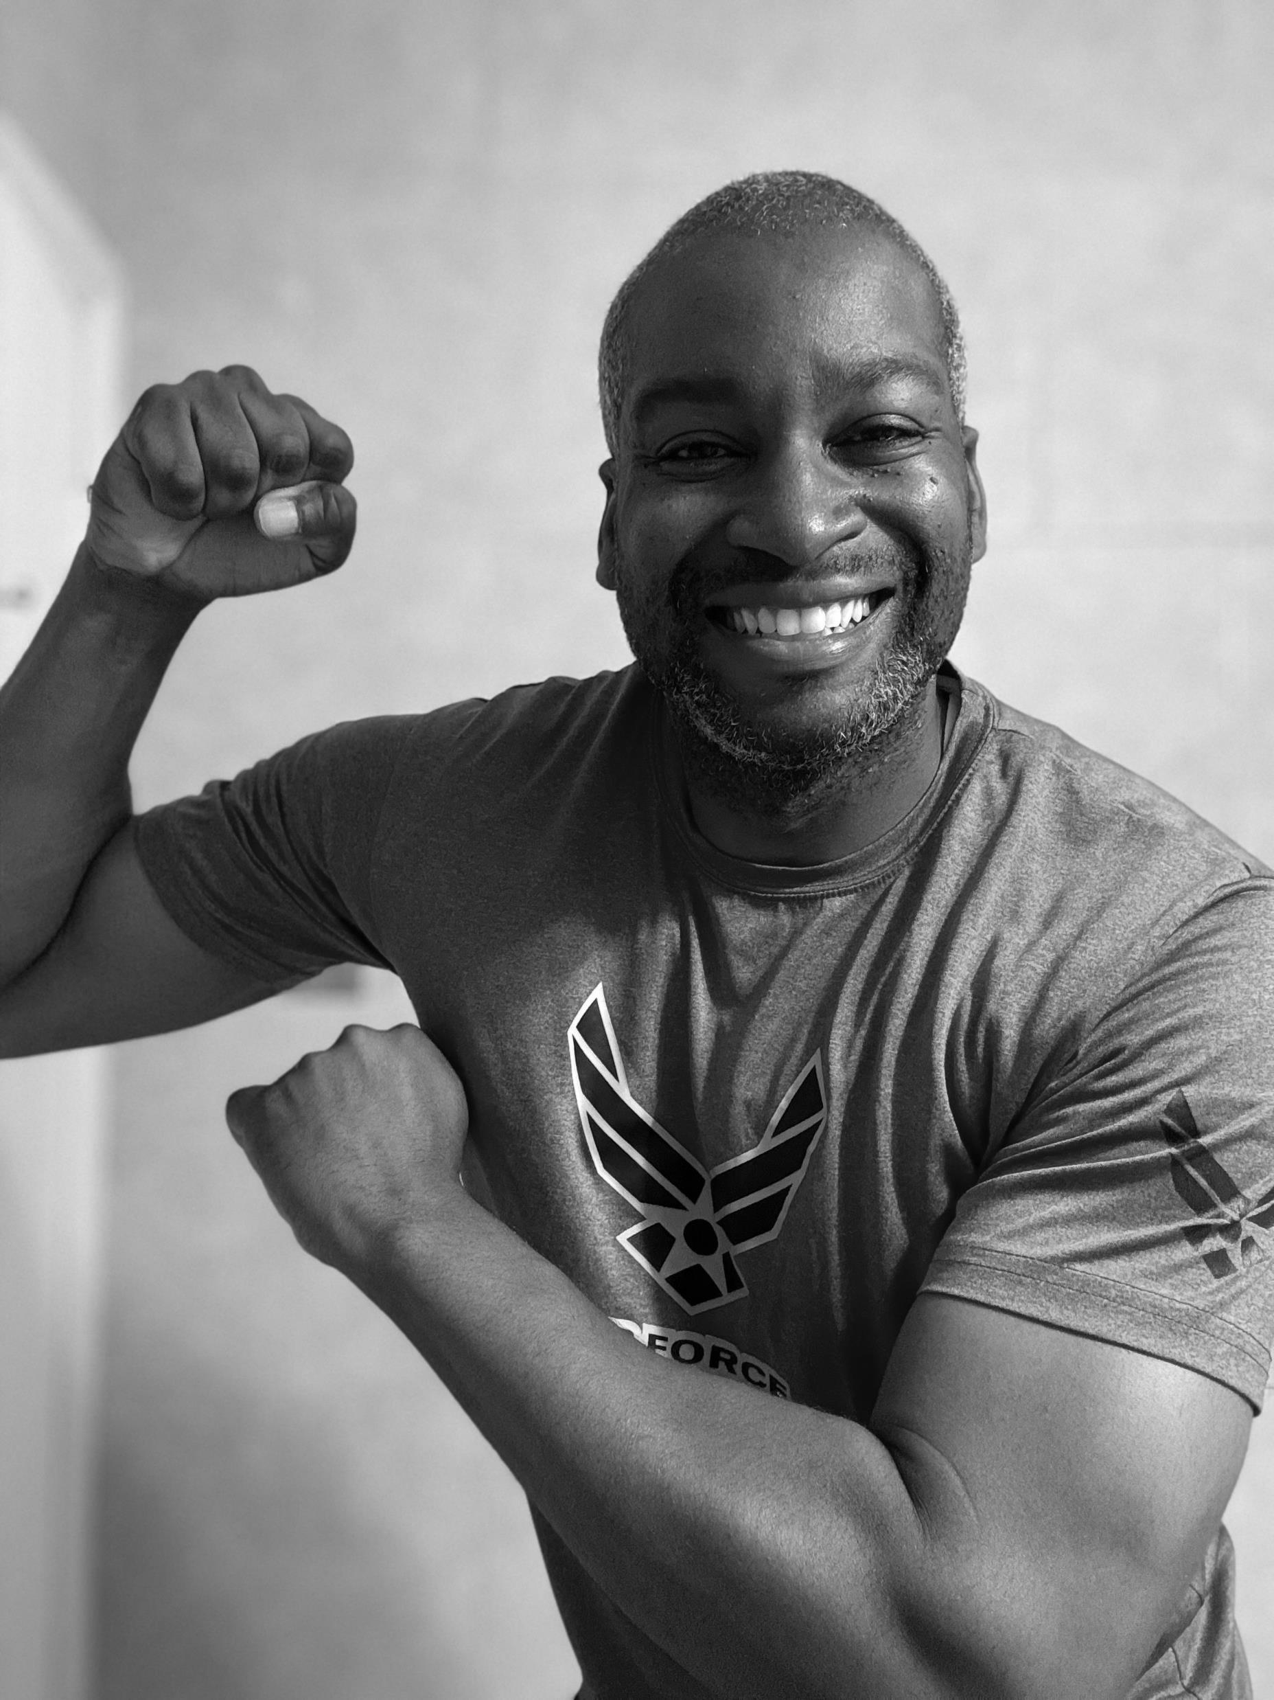
Main Character
Biography
Body type: Lean/fit-Ectomorph-has a relatively fit body with muscle mass in form, average weight for his height and decently proportionate throughout without an excessive amount of body fat
• Eye color: Brown
• Face shape: Average Oval shape
• Prominent features: Character has a mole on left side of face, slender, fit guy, medium size nose, long eyelashes (from his mother’s side)
• Tattoos or scars: scarred on right side/oblique area/next to rib from Right-Lung Collapse and surgery
• Casting choice (what actor do they resemble?):
Denzel, Samuel L. Jackson, LeVar Burton, Lance Reddick, Chadwick Boseman and Laurence Fishburn

Slide 8
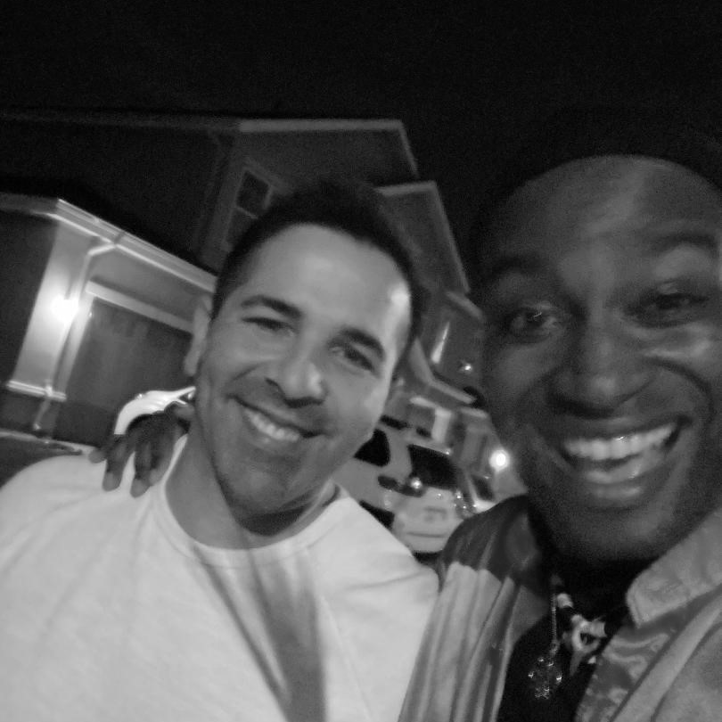
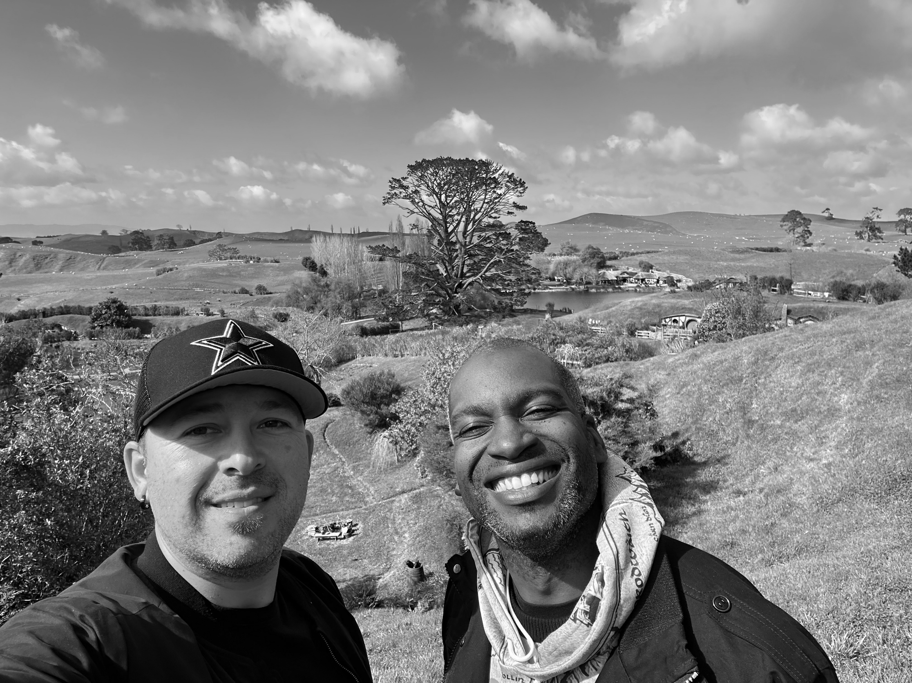
Main Character Biography
The protagonist is very loyal with his friends. Friends are not like family… they are in many ways a lot better. Family is something you are born into and many go their whole lives believing they should receive a certain level of compassion accordingly because of the bloodline-but this is far from always being the case.
Unlike all of your “family” friends choose you and often become closer than those in your family to begin with. The camaraderie that he has with his friends is unmatched. This hinges off the reasoning all of his friends are chosen by the higher power. His faithfulness to them and the gospel is rewarded by the members being chosen to serve around him being those he has ben able to trust the most.

Slide 9
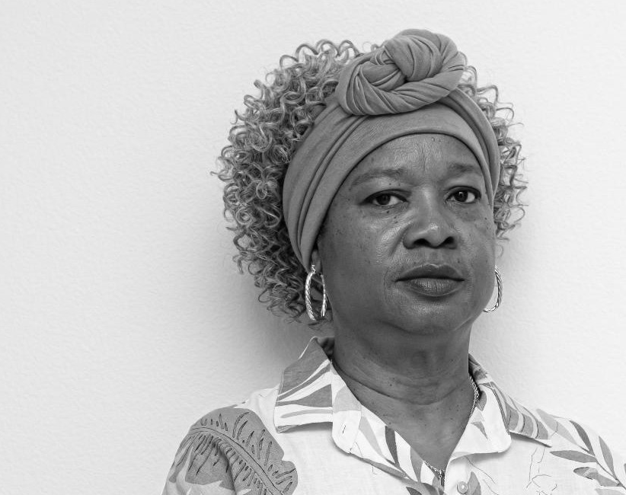
Supporting Character:
Cynthia
This character is the strongest of the
Group outside of the Chosen One.
She is the Heavenly Messenger here on earth
to be the guide for those in the fight and to be an ear
to the sky to listen in and understand the things of the
Lord that are taking place. The sacrifices she must make for
the country are immense in this volume and involve the deepest
emotions and trust in the Creator for her to be able to carry
Them out as she is supposed to. As a woman who took on the
role replacing the previous one who lost their title, she has had to
come a long way to be where she is in her powers.

Slide 10
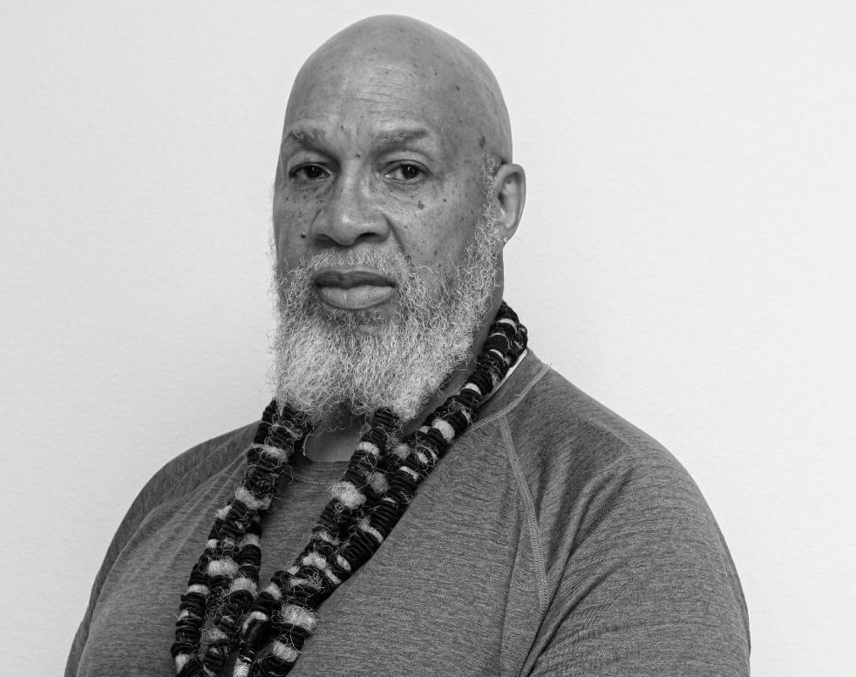
Supporting Character:
CB
CB- the father of the Chosen One and the husband of the Heavenly Messenger has both a humbling and very strong job. His role is to step aside and in the things of the Lord having to do with these conflicts he is the one to push forward and do what must be done for family while kindly stepping aside and allowing his wife and middle son to lead the way for the embitterment of the future of the souls of the planet and ultimately for the glory of God!

Slide 11
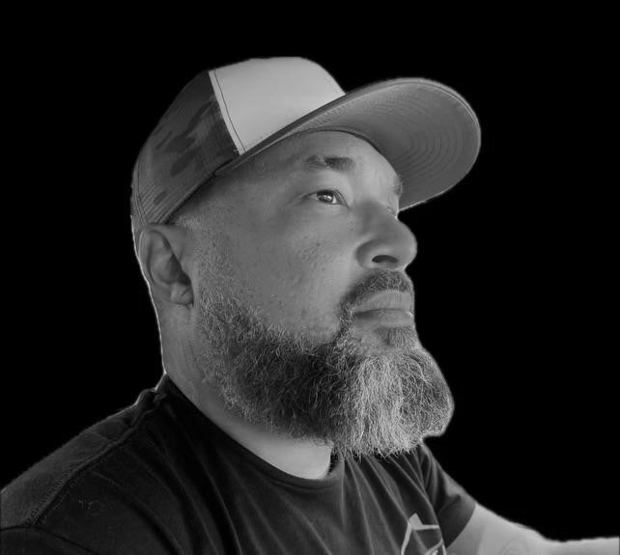
Supporting Character:
Junior
As the older brother to the Chosen One, just like their father,
Junior has to take a step back and allow his middle brother to lead
Family in form while also supporting him and being a shoulder to
Lean on during hard times that he naturally has as a human. Junior
Has a strong role to lead his brothers as he can while also understanding
Their respective gifts and allowing them to lead accordingly.
Once the Chosen One was switched to the family, the roles of the brothers changed
Immensely and Junior had t come to grips that the Lord chose his younger
Brother to lead the way in the conflicts to come. Junior is wise and humble
In his power ad role and takes it with stride.

Slide 12
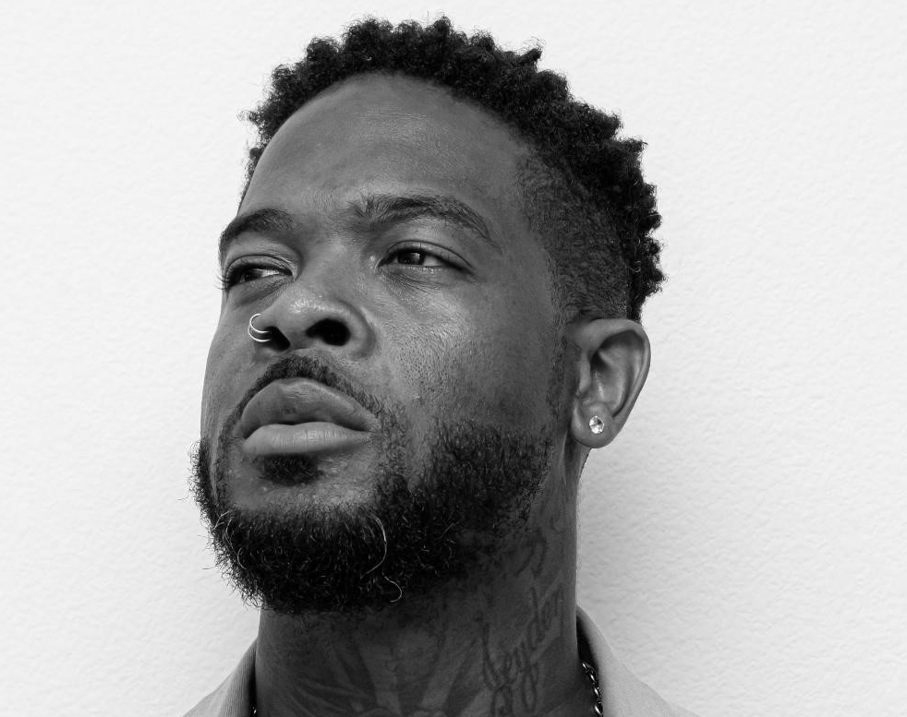
Supporting Character:
Chasman
As the younger sibling, Chasman has the
Responsibility of allowing his older brothers to
Lead the way while he watches on as they do so
They do an awesome job working together, and
Even when apart, cannot surmise ever going
Against each other as each of them have had
The best and most awesome relationship any
And all brothers should and could have. Chaz’
Power is as unlimited as his brothers but is
Off the strength of hi middle older brother,
Who both he and his older brother aspire to be
Like. They’re connection is undeniable.

Slide 13
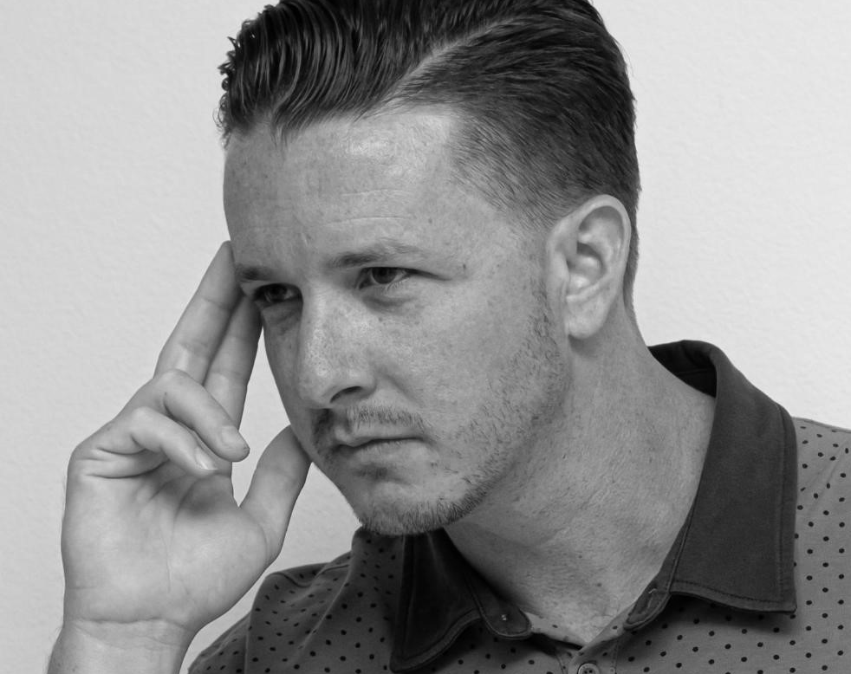
Supporting Character:
Tyler
Tyler, who is also a Pastor is the best friend and
Brother level type of the Chosen One. His power
Consists of him being able to speak to minds
At any distance and connect them with other minds if
Needbe. He works as a mentor for the Chosen One,
But gladly takes the seat of support and follows his
Frien/brother wherever he may go.

Slide 14
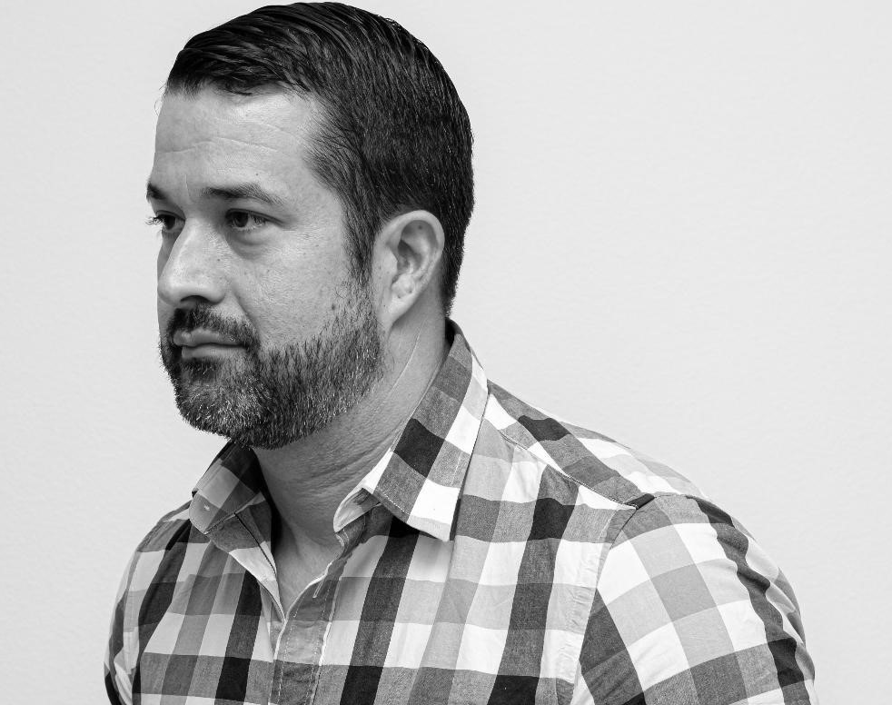
Supporting Character:
Dan
Another best friend and brother, Dan is and
Always will be one of the closest people in
The Chosen One’s life. Knowing him for so
many decades, he is the one who has been
With him the longest even more than his
Adopted family that he now stands shoulder
To shoulder with. Dan’s power is a step up
From his actual job as a detective and he has the
Ability to see and sense things from a very
Fr distance and can engage accordingly. Just
Like Tyler, God has anointed him to be one of the most
Powerful frends in the Chosen’ One’s life because
Of his close relationship with him. He would
Do anything for him and remains faithful.

Slide 15
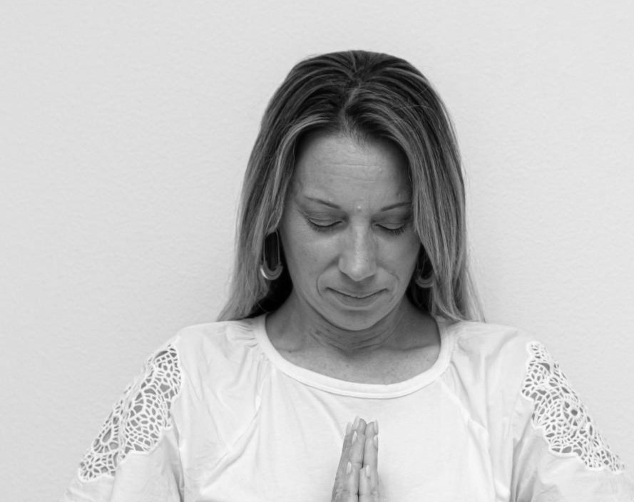
Supporting Character:
Jen
Protector of Future Angelic being and wife of Dan

Slide 16

Supporting Character:
Justine
Creates soundwaves with her mouth and is the wife of Tyler

Slide 17
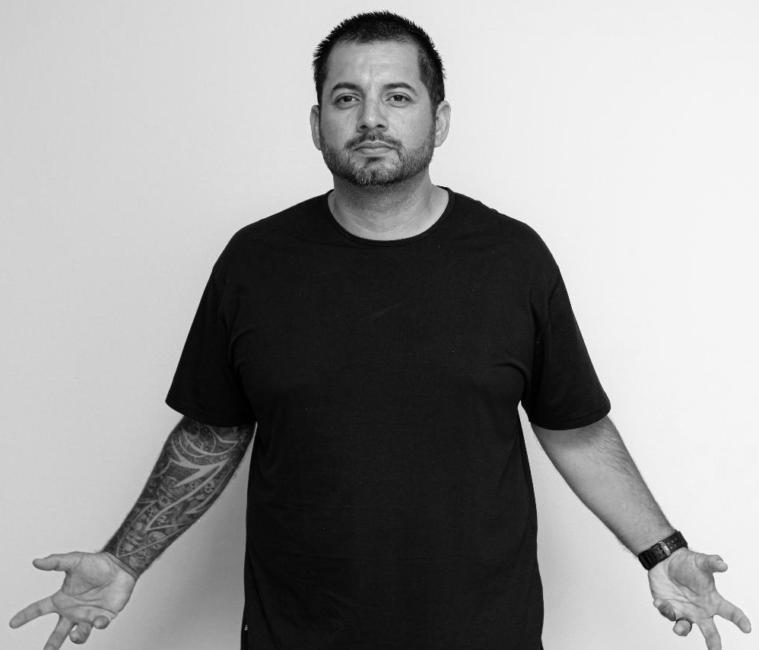
Supporting Character:
Mike
Creates electrical currents from his hands and is the brother in law of Tyler and Justine and the husband of Ashley.

Slide 18
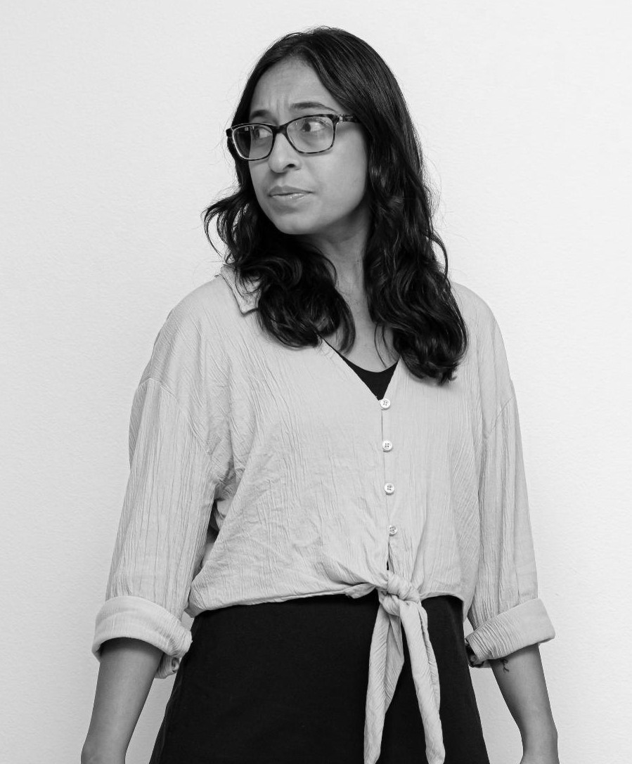
Supporting Character:
Ashley
She wields a bow an arrow that is filled and fueled with electricity. She is the wife of Mike and the sister in law of Tyler. Justine is her blood sister.

Slide 19
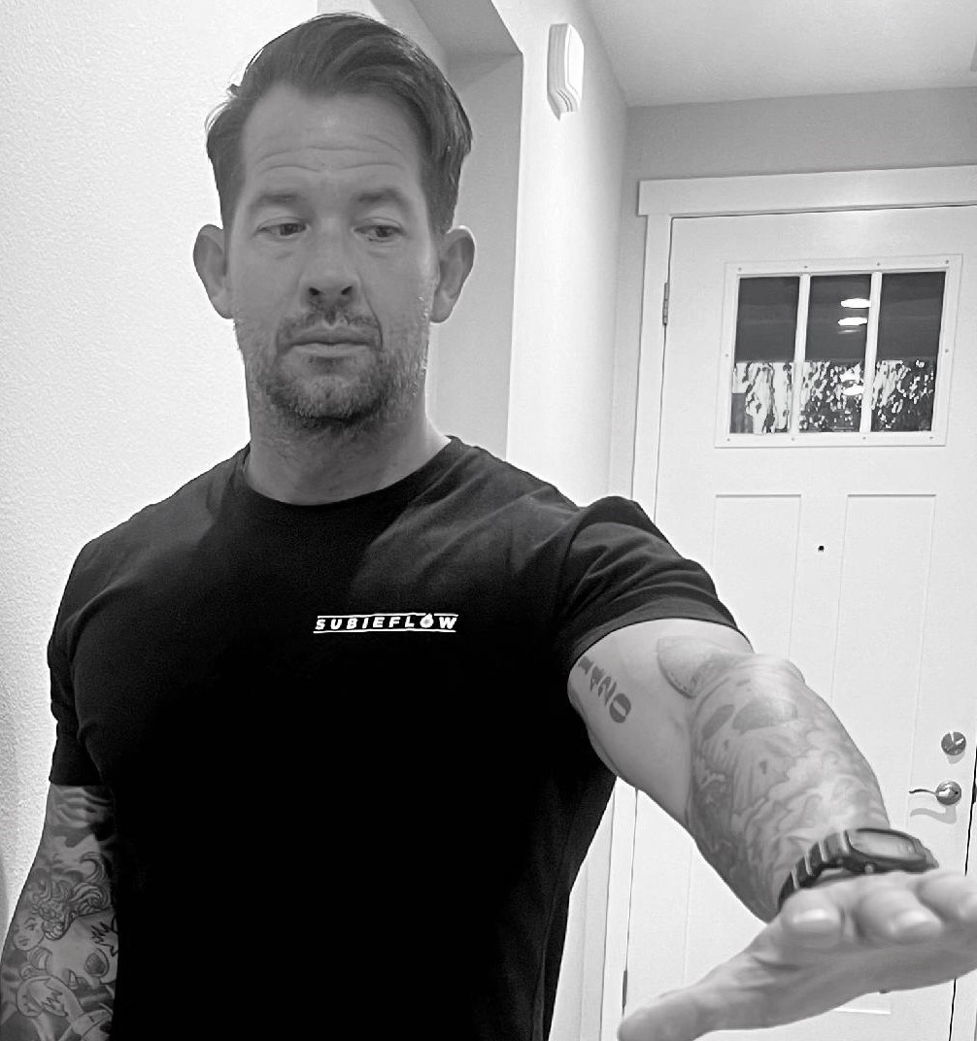
Supporting Character:
Stephen
An army vet and no firefighter, he is the brother of Dan and naturally the close brother-type of the Chosen One and almost as powerful as his older detective brother. His power is to wield fire at any length and strength he can handle.

Slide 20
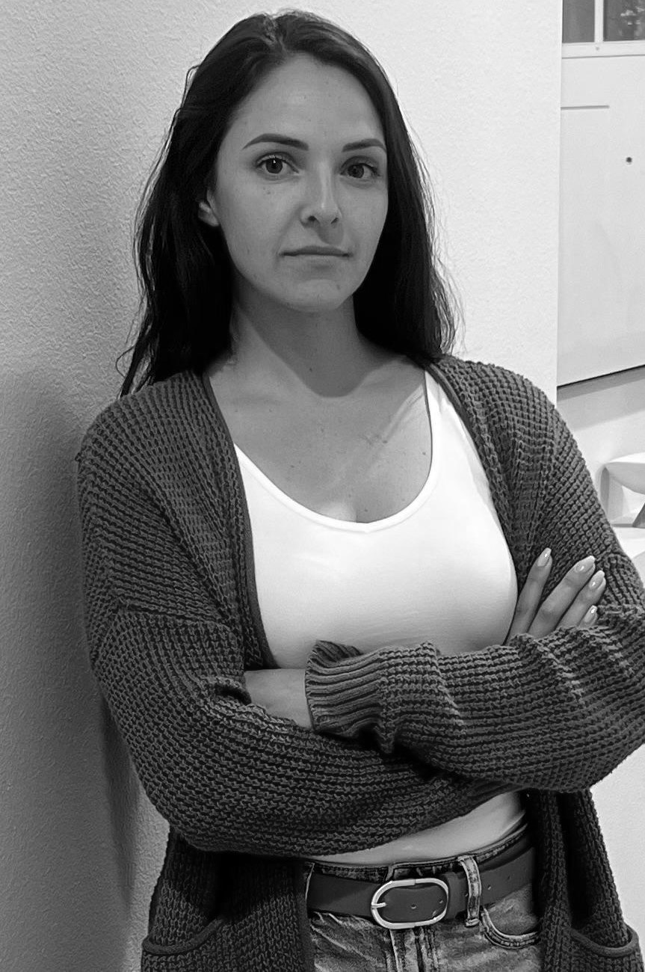
Supporting Character:
Tonya
She is the wife of Stephen, sister-in-law of Dan and Jen and close family member of The Chosen One. While she holds an office in the Whitehouse, she also is able wield any type of bomb she can think of and is very destructive and efficient with it when the time comes.

Slide 21
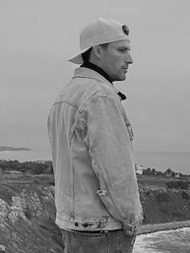
Supporting Character:
Scotty
The younger brother of Tyler and close friend/brother type of the Chosen One. His power is to wield any type o knife he can muster up and has an exceptionally accurate throwing arm to ensure his blades land on target every time. He’s young but willing to do anything to support his older-brother type, as again, as far as he is concerned-he’s family.

Slide 22
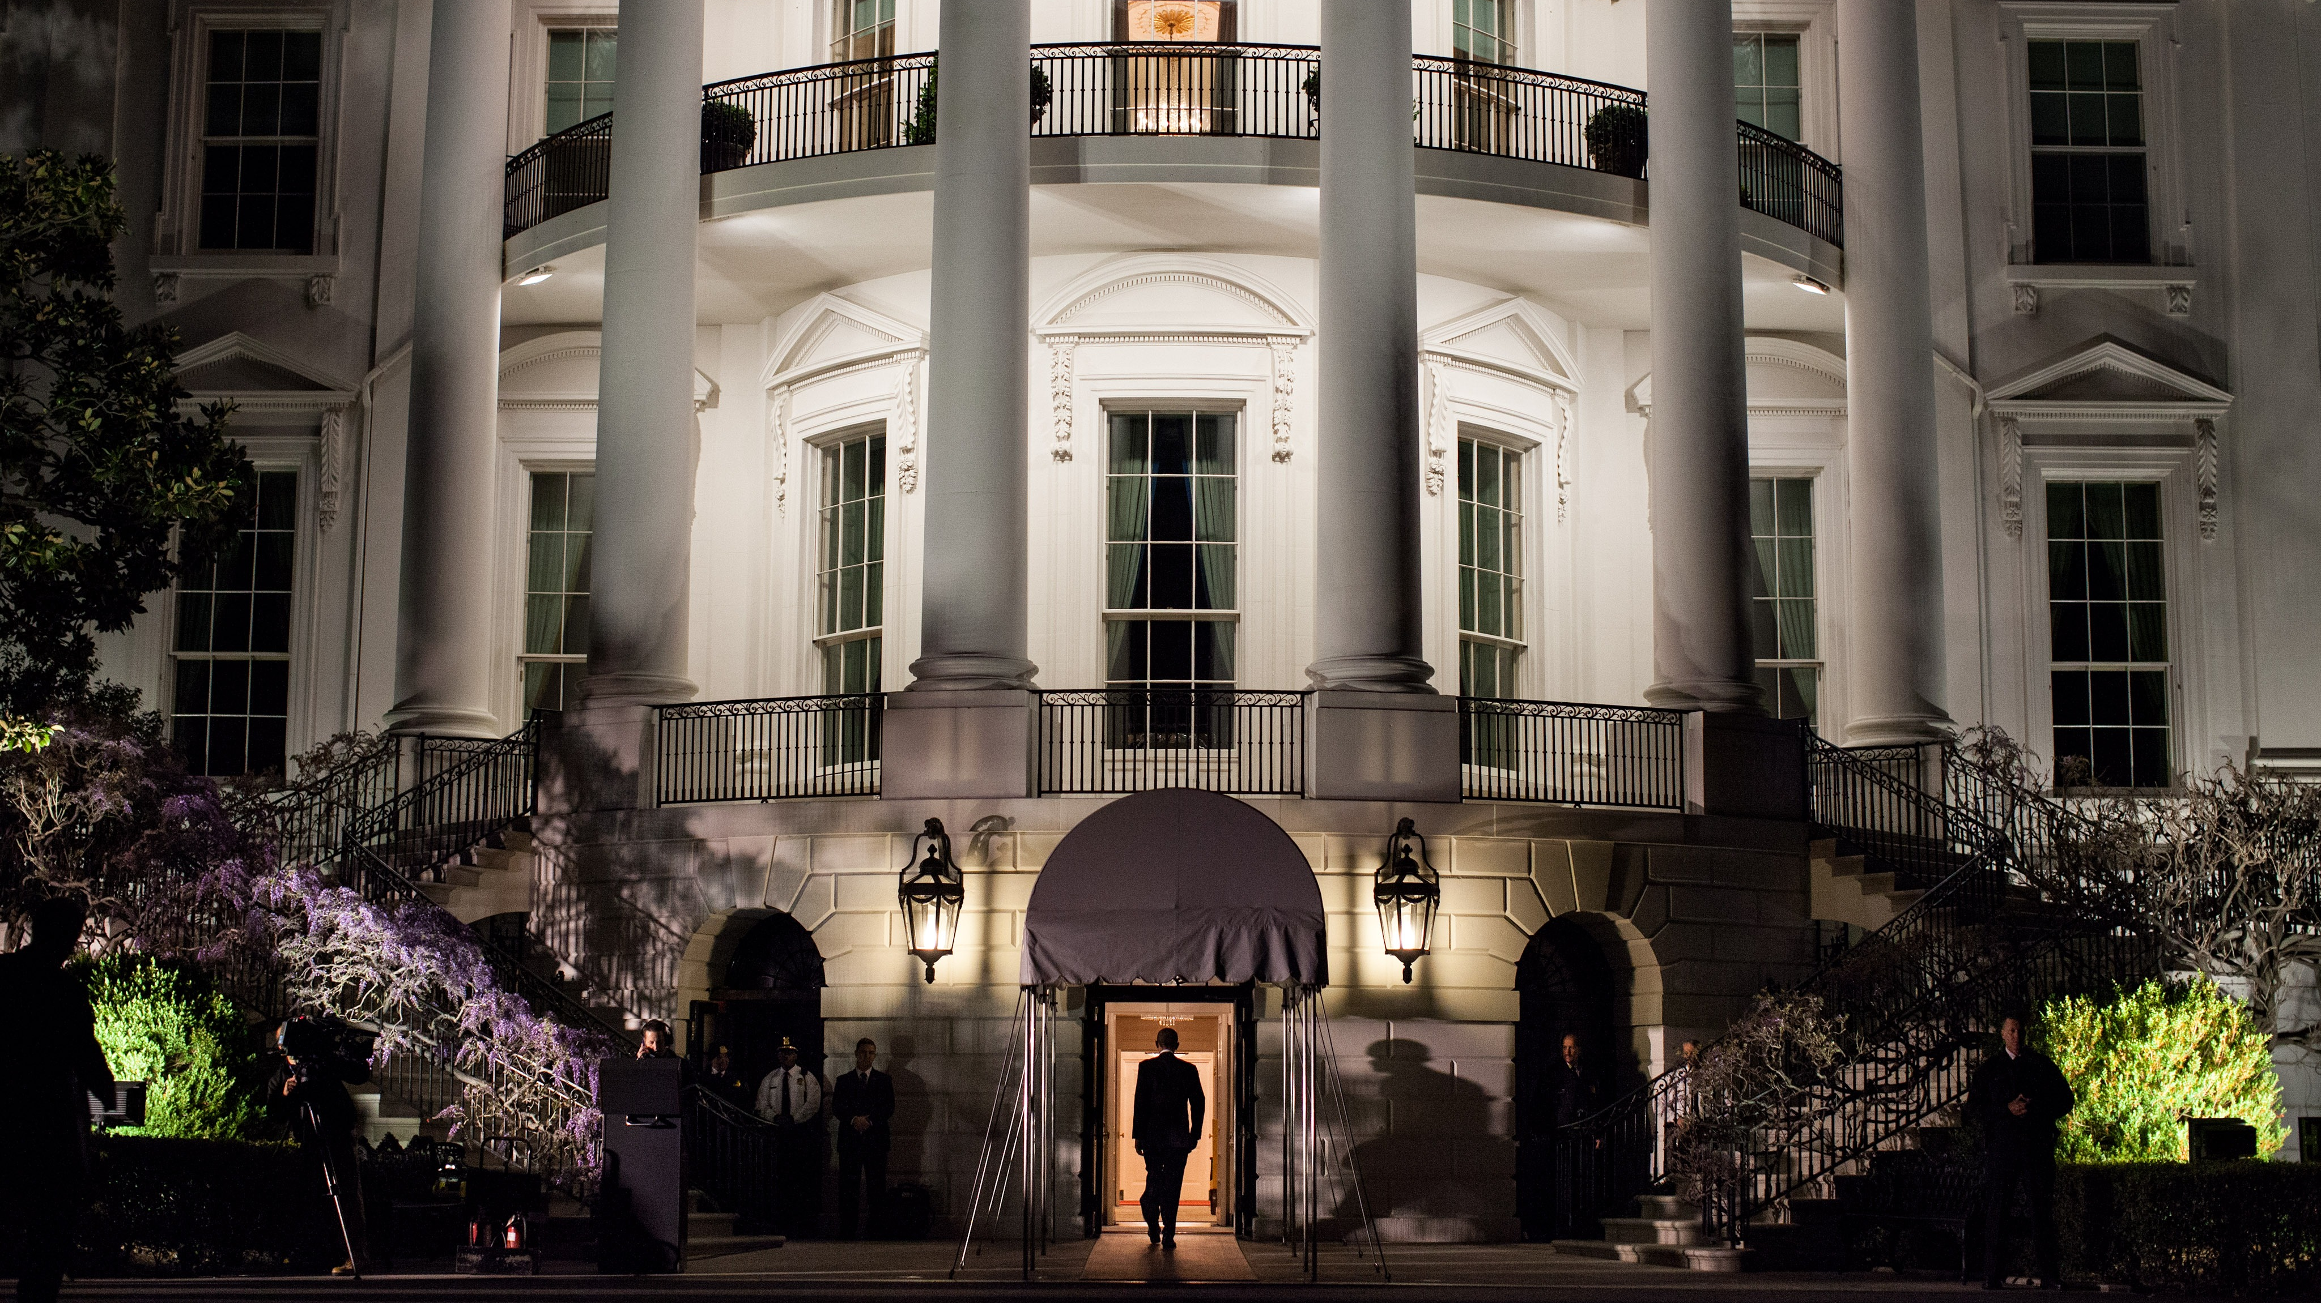
Supporting Character:
The President
The President is the lead political move on this plot and assists the Chosen One in executing what becomes a global threat and response situation. For years the POTUS had ben working on getting policies signed to ensure this was passed in the way it needed to b by the time the conflict occurred, and he was able to do so and ensure that the Chosen one had all the support he could get.

Slide 23

Supporting Character:
Rosetta
A reporter who was not a huge fan of the President or the Chosen One end up working with both and by the end of it she is saved, her heart is changed and a hatred she had for another is reconciled proving that the Lord has a purpose for everyone, even if we can’t see it. Despite her negative outlooks the President ends up taking her in to assist in the conflict and her skills help the greater cause immensely-bringing glory full circle to our Creator.

Slide 24
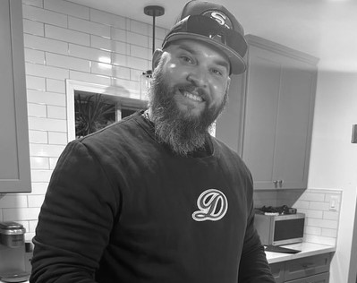
Supporting Character:
Sgt Gallmeier
Initially, unaware of how important his role would be
This marine veteran, now a pastor becomes a protector of the
Reporter just to end up ministering to her in a big way, praying
For the entire country live on camera and helping to bring many people
To God while the conflict was under way. He holds no particular power role, but the
Part that he played was essential to the success of the mission set out by God.

Slide 25
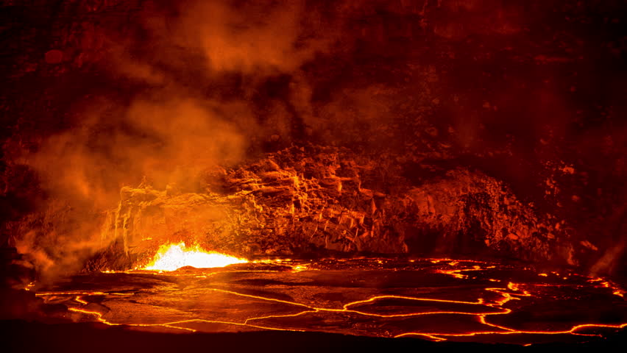
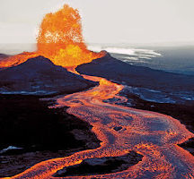
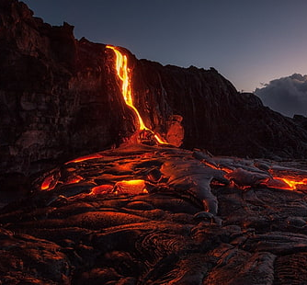
Location:
Big Island of Hawaii
Kilauea- the is where much of the first battles in the story exist and are fought lead by the Chosen One. In the story the volcano is dormant for decades but then comes alive when the diamond that has been placed there becomes more volatile than eve the enemy expected.
It becomes a race to retrieve it and use it as a means to destroy the world but little by little it begins to change the environment in which it sits. Only powered beings can go near it and such mayhem, which is why the Choen One and his allies have to be the one to put an end to it.

Slide 26
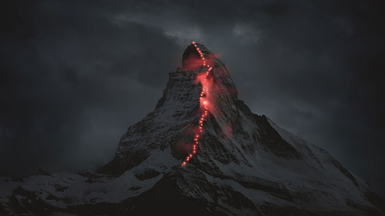
Location:
Mount Everest
Much conflict in the story occurs at and around this location in the story, where the Chosen
One’s older brother is leading a team to recover one of the acclaimed power diamonds.
With many companions assisting him,
Junior is challenged to engage with enemies
near and on this peak in order to conquer
his mission while KJ retrieves the one in
Hawaii and Chasman guards and protects the
dormant one, currently hidden at the Pentagon.

Slide 27
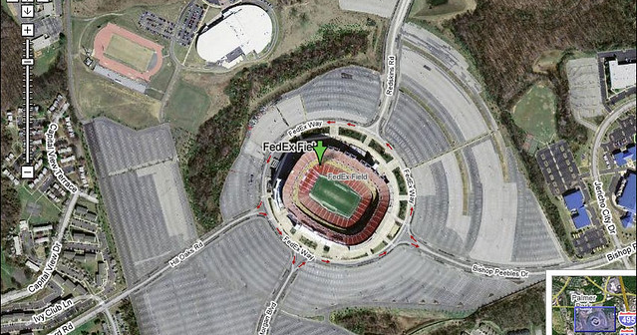
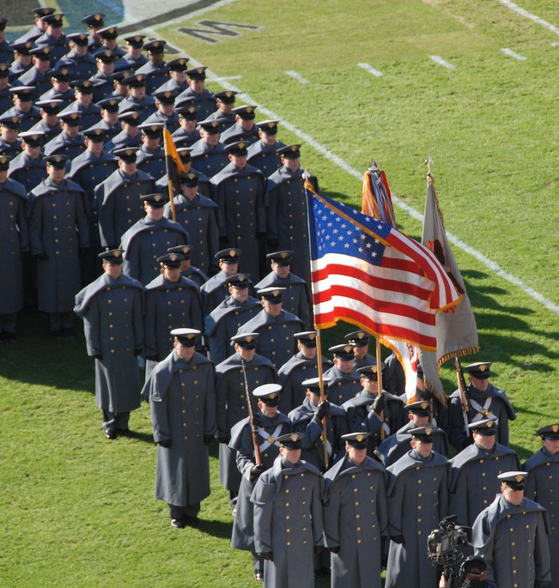
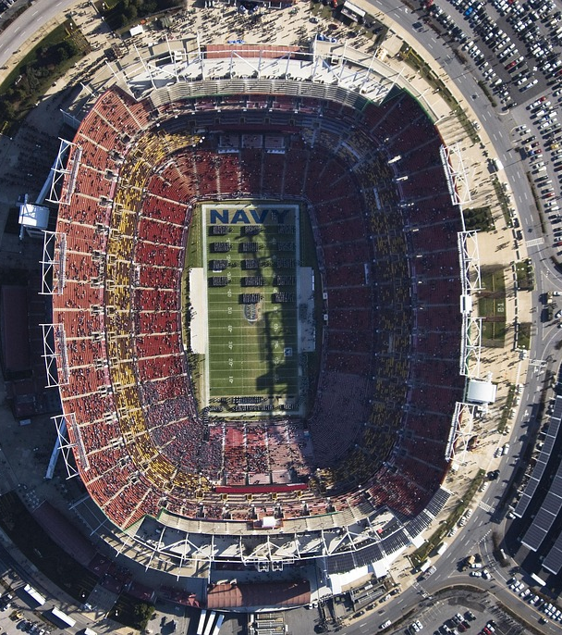
Location:
FedEx Field
This is the location located closes to Washington D.C. where in the story the President is visiting to view a game. Little does he know is that as the plot of the enemy begins to unfold this is where the enemy will strike first in order to try and take out the POTUS before he and many other leaders with him have a chance to try and foil their plans. It’s realized early on how intricate his position is with the policies he worked to put in place, so the enemy sees him and other allies as a threat and work to try and kill them before the actual attack on humanity begins.

Slide 28
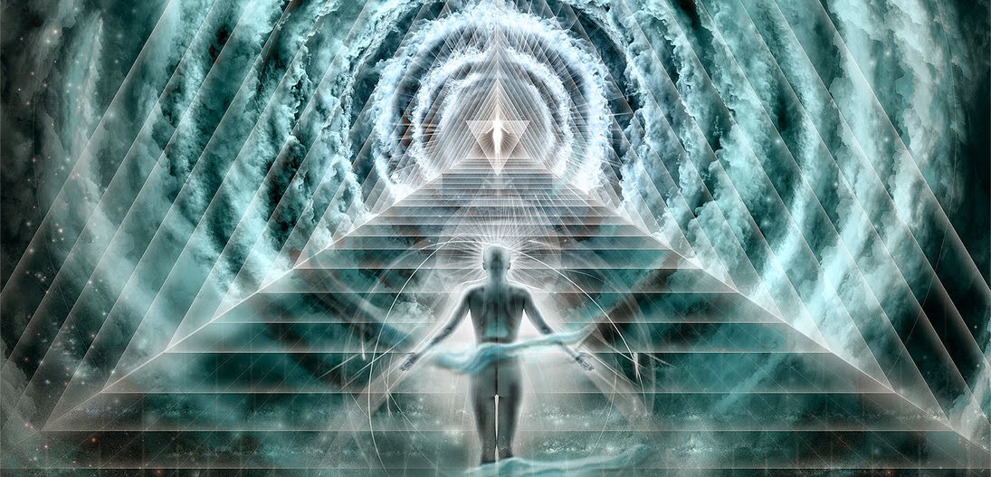
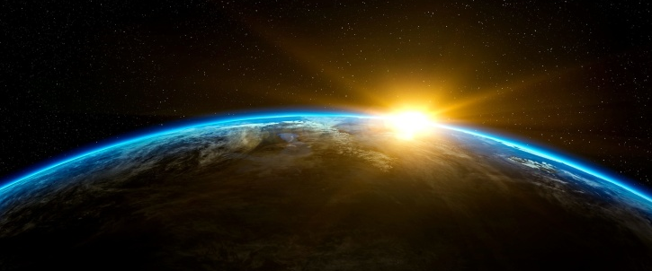
Additional World Info
Two realms exist in the story, one in the earthly realm and one in the spiritual realm.
The Heavenly Messenger is the only being granted the ability to commune with both
simultaneously without distraction or delay. While no human will never know all
or as much as our Creator, she is the closest one on the planet.
Her son, the Chosen One, can commune if sought, but his purpose lies with
his focus on the earthly threats and it isn’t until his rehabilitation that he learns
to grow in that area.

Slide 29

Additional World Info
The plot of the story is circumferenced around three diamonds. These diamonds were strategically placed by the enemy for decades, but what one meant for evil, God can turn for good.
While the enemy focus’s on retrieving the diamonds and the magic they helped orchestrate within them, the three brothers (chosen by God) carry out a mission to capture, reverse its hold on the earth and then destroy them. The diamonds, while evil, makes the world come together in a global way that the enemy did not anticipate.

Slide 30
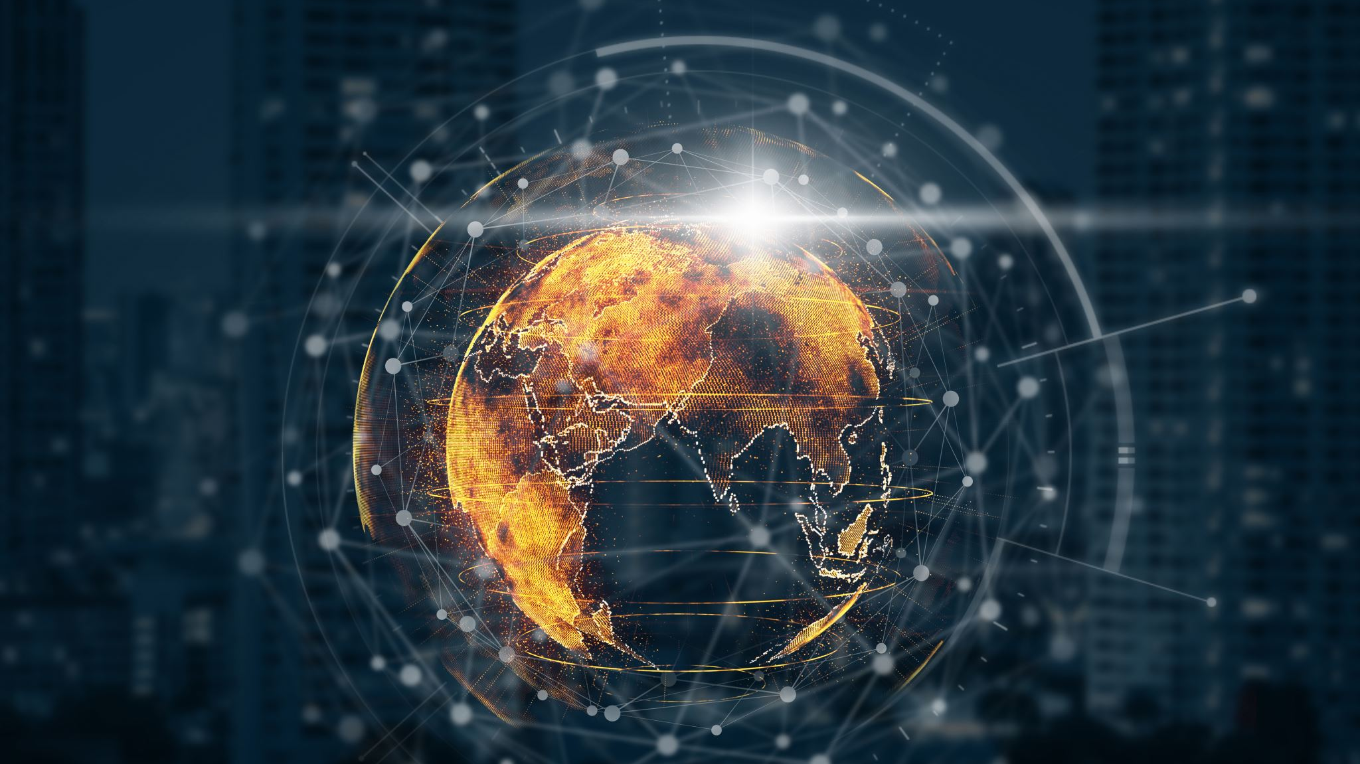
Additional World Info
While the heroes anointed with power by God have their power given from a divine force, it causes confusion
on how the enemy acquired power over the years without it. Through black magic, the enemy placed the
diamonds around the world that would absorb all the negative and evil energy exhibited from those on the planet.
So, the diamonds through magic and dark science are a sum of the evil in the world, but it’s the good in the world,
through the grace and guidance of God that allows for this dark scenario to be dealt with while serving many
souls and enriching the Heavenly Kingdom along the way.

Slide 31
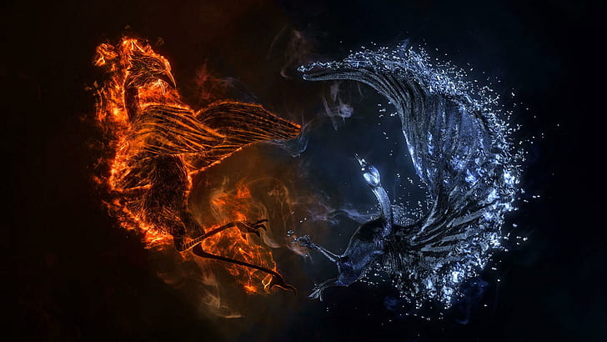
Story Synopsis
In the spring of 2023, after almost a 20-year gap since the last spiritual conflict (2004), a new threat arises for KJ to combat when, Abaddon, an earthly servant of the devil (and KJ’s biological father) produces a plan to dominate humanity with malice and destruction via infiltrated diamonds of their own making. Despite being in a difficult times himself, once he and some friends are attacked, as well as the current President of the United States, KJ is pushed into action and must prepare to face and conquer another evil force.

Slide 32
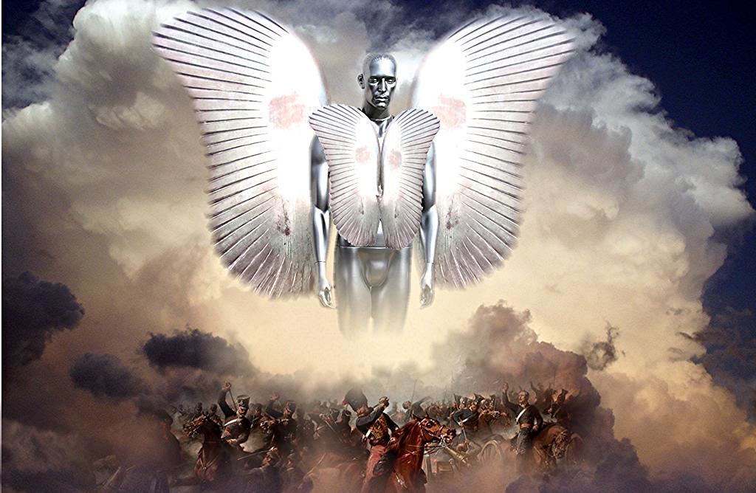
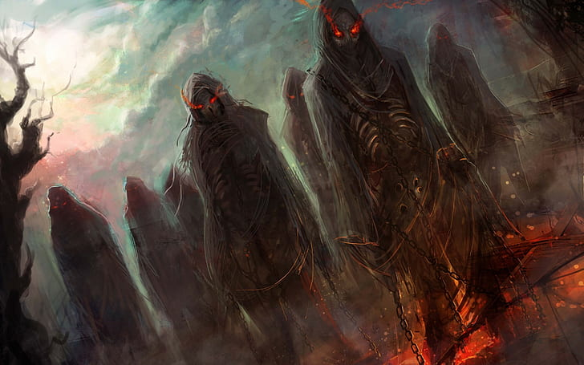
Story Synopsis
The antagonist plan of collecting evil creating diamonds from three separate locations for world dominance is the plan KJ and his allies must stop. After immediately ensuring a dormant diamond is secure at the Pentagon, an angel of the Lord is then sent to distribute powers to the faithful team of heroes who will embark on a mission to safely retrieve the other two active diamonds, while the world watches. These diamonds must be retrieved by KJ and his team before the enemy gets it, in order to save the bodies and souls of the earth from being destroyed.

Slide 33


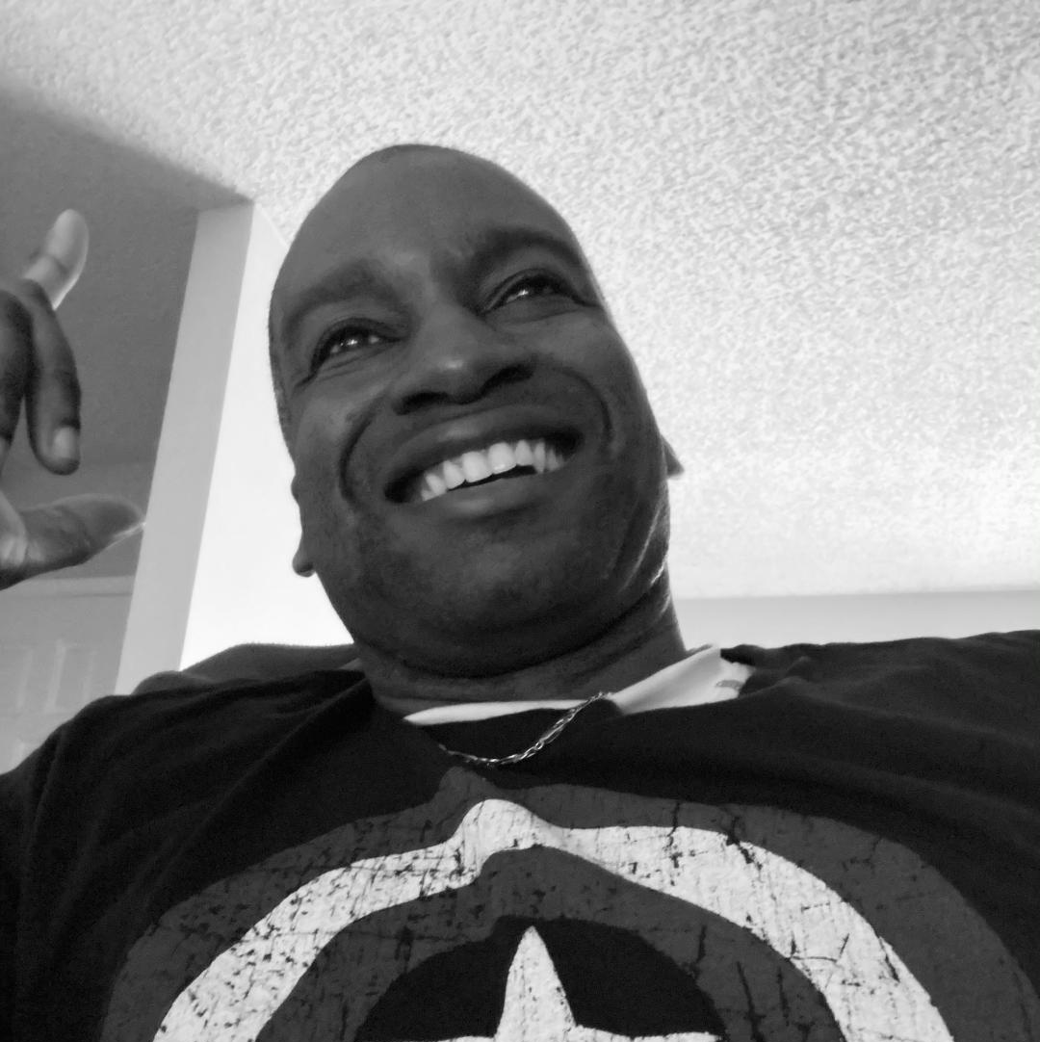
Story Synopsis
As the end nears, KJ, nearly loses his life before being rehabilitated and coming back strong as ever to finish defeating his father and the surrounding foes he has created. Once his father is defeated the diamonds are reunited and destroyed and all enemies are neutralized and the world pushes on back to a form of normalcy
It’s in this that KJ realizes the Lord’s plan all along and that he wasn’t being ignored and forgotten about, but that the Creator was making him that much stronger in order fight the largest of battles he would face with a world of support to back him.
This “calling” was his “destiny” and the depressive clouds had finally diminished a bit, so he could see it.

Slide 34
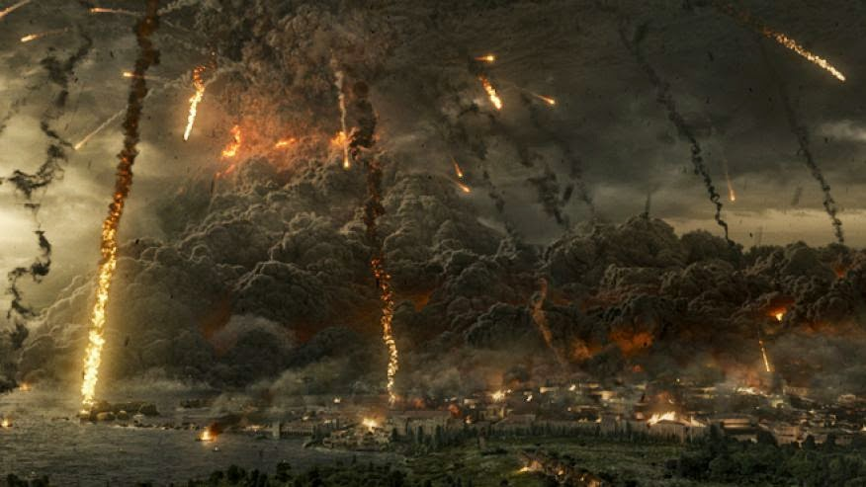
Story Excerpt
Tyler, DTM, and the team continued to fight their way through toward the volcano and began to slowly make their way back toward it, when a large wave of hostiles came rushing out of the ground and the mountain.
“Where the heck did they come from?” Scottie said. Regardless of this sudden increase enemy manpower, they kept fighting through. Even Gallmeier and Josiah joined them as they saw them beginning to be overwhelmed while Cox and Catalan took up arms to protect the civilians and the ship as Kody put up a wall around the ship to add another layer of protection. Soon though, they were beginning to be surrounded by the hostiles, but they would not falter and would not hesitate to keep fighting through. They all looked at each other, knowing that giving up wasn’t an option as Tyler whispered in all of their minds. “Briton might want to start forming as many of yourselves as your power can take you, brother,” Dan said, looking over at him and then Tyler.
“To the end, my brothers, to the end.” Then, a sprinkle of rain came from the sky, a little at first, and then more than a mist, but contact drips, but ones that seemed to be sorta isolated. As the drips hit the ground, they began to form and come together (sort of like that scene from T2 when the liquid metal guy’s body started coming back together). The water formed more and more, and then it rose in the air, beginning to circle, and both the team and the hostiles paused, not knowing from which side this new figure would align with. The power working the water in the air continued to form until it eventually formed into a body, and then that body shot down like a light.
“Cancel that order,” DTM said. The form then shot up in the air and began to glow immensely as it went up.
“How do we know whatever this is, is it on our side?” Josiah stated. A power surge then shot from that form and imploded over them with a shield to guard them from the danger to come. “Oh, never mind, never mind.” DTM smirked, having a feeling what this was. The form then shot down toward the middle of the hostiles, blasting into the ground, sending most of them to their backs while vanquishing and crushing many others.

Slide 35
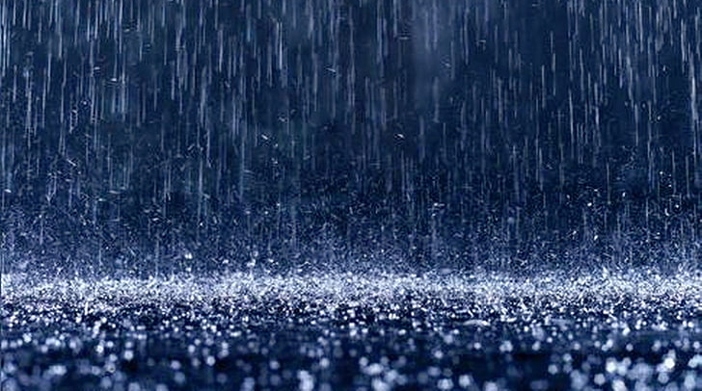
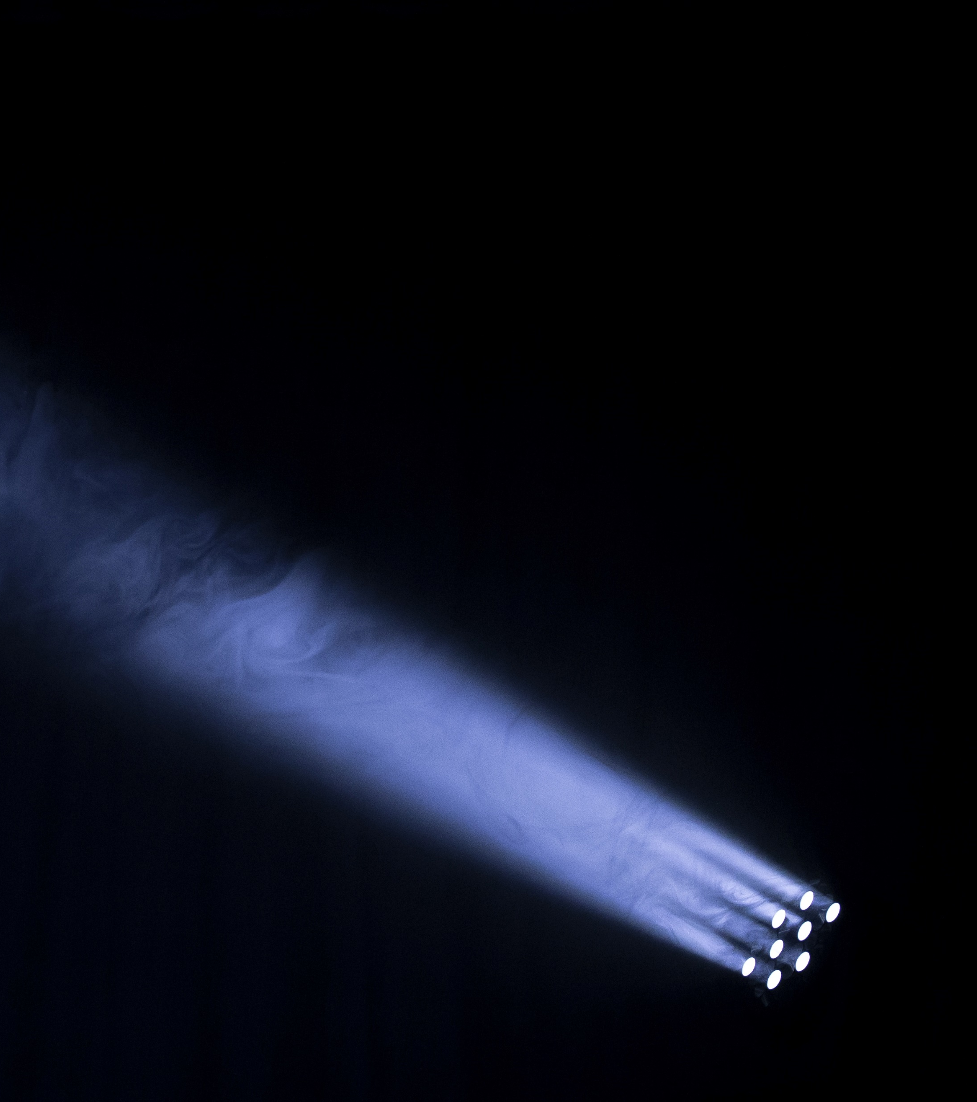

Story Excerpt
A large beam then shot across the plain from left to right/east to west, and then the beam shot up in the air and extinguished most others to the north and south and sending many to the ground. Once the light dimmed and the dust settled, all that could be heard was silence and the occasional moans from hostiles who had survived and were slowly getting up. The figure then turned around to then affirm that it was . . . me. The team all grinned from ear to ear, trying to home in their excitement as they knew more battles awaited them, but as far as the rest of the world, they didn’t have such limitations.
“He’s alive—praise God!” Ms. Busby said.
“That’s what I’m talkin’ about . . . Get em’, buddy,” Danny stated, putting down the weights and turning the TV back up in the gym.
“Your brother’s back,” the bartender said to Gabby, who looked over at SFG Bunkley, who swiftly wiped his tears.
“Yes, he is,” Gaby stated. Bunkley shook his head, grinning.
“The enemy is in for it now.”
Mr. Higginbotham looked back at Brian. “Not that he wasn’t cool before, but that was quite an entrance. Your bro came back a total badass.” Brian grinned and sat back on the wall he had sat on with a sigh of relief.
All at the Pentagon rejoiced . . .
General looked back at everyone in the office. “Looks like your dude just made the comeback of comebacks.” They all smiled. Jason looked over at the general.
“I knew it, I knew it all along.”
“Yeah, you did, kid; yeah you did.”
My dad grinned, looking over at my mother and my brothers in their separate places and could feel I had returned. We were connected, we were all one, and we were going to finish this thing out together.

Slide 36
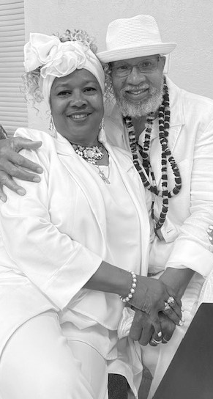
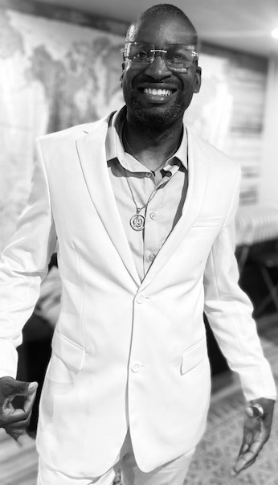
Story Excerpt
As I looked back on the team, I smiled, as I was so happy to see them but well understood the painful moments they had just endured believing I was gone. They started walking closer to me. I placed my hands up, releasing the shield around them, but then also, we had to make a change.
I pointed toward them all, and an array of power swirled around my hand and then around all of them, and now they were all in white as I was. This change reached my older brother’s team, my younger brother at the Pentagon, and my parents. Each of them left in white in their own style. White was associated with the triumph of light over darkness and life over death and was sustained as a renewal, a rebirth, and a refresh.
We had conquered a lot up this point, and now we were renewed. I came back rejuvenated and ready to lead them the right way. With the change of their clothing also came the elevation of their power abilities. You are as strong as the team you keep around you, but the team is as productive as the leader directs. We had been helping each other; we’d done this thang together, and through the trial, we were now stronger for it. HUA!

Slide 37

References:
1. Pic of war of gods
https://www.wallpaperflare.com/battle-of-gods-wallpaper-weapons-army-being-art-the-sun-s-rays-wallpaper-stwuy
2. Pic of sunset over a land and water
heaven-vs-hell-wallpaper-preview.jpg (728×284)
3. Johnson, K. (2020, Dec 13) Pic of author looking back in white shirt while wearing black coat
4. Johnson, K. (2006, Mar 4) pic of author looking to the side while at a restaurant wearing black suit jacket
5. Johnson, K. (2021, May 10) Pic of author staring into the camera in black and white
6. Johnson, K. (2021, February 27) Pic of author in Jedi/authentic priest costume
7. Johnson, K. (2019, Nov 20) Pic of author while deployed to PSAB

Slide 38
References:
8. Johnson, K. (2024, June 5) Pic of author flexing in Air Force Marathon shirt
9. Johnson, K. (2021, Oct 30) Pic of author and supervisor while at a Fall parade on Beale AFB
10. Johnson, K. (2024, Sep 8) Pic of author and friend while visiting New Zealand
Photos 11-12, and 14-21 all taken- Professional book pics (17 Aug 2024)
https://lolajoephoto.com
13. Johnson, K. (2024, Aug 17) pic of author’s older brother to credit toward book
22. Johnson, K. (2025, Mar 25) pic of friend on the beach
23. Night shot of the White House as POTUS enters
the_white_house_washington_d_c_landmark_historic_historical_president_obama_portico_columns-1130474.jpg!d (1200×799)

Slide 39
References:
24. Back of female journalist taking pics
sam-mcghee-KieCLNzKoBo-unsplash.jpg (5760×3240)
25. Gallmeier, A. (2023, Dec 24) pic of guy cutting roast beef on Christmas Eve
26. Erupting Volcano - https://ak.picdn.net/shutterstock/videos/9893900/thumb/1.jpg
27. Lava oozing over from Volcano-beginning to slow- 8276459416_5a4afe119c_b.jpg (1024×768)
28. Lava flowing from Volcano- nature-volcano-lava-hawaii-wallpaper-preview.jpg (728×486)
29. Evening view of Mount Everest- nature-mountains-mount-everest-landscape-wallpaper-preview.jpg (728×410)

Slide 40
References
30. Overhead shot of Fedex Field- https://cdn.pixabay.com/photo/2013/03/04/04/16/landover-89813_960_720.jpg
31. Distant aerial shot of Fedex Field - https://ggwash.org/images/posts/_resized/RFK_parking.png
32. Troops on/around Fed Ex Field- https://www.forceswatch.net/wp-content/uploads/shutterstock_1438347449.jpg
33. Re-incarnation pic of member entering different realm-
https://i2.wp.com/www.thelastamericanvagabond.com/wp-content/uploads/2016/02/light-energy-being-life-after-death-soul.jpg
34. Pic of a space-shot of planet earth as the sun makes its rounds on opposite end.
https://c4.wallpaperflare.com/wallpaper/877/250/576/earth-sunrise-from-space-wallpaper-thumb.jpg
35. Pic of three diamonds d6q1b2d-180753bd-7fb9-4624-9686-6e7dee935e9b.png (1920×1080)

Slide 41
References:
36. Spiral of white light- https://images.pexels.com/photos/50586/steelwool-dark-firespin-spiral-50586.jpeg?cs=srgb&dl=lights-night-dark-50586.jpg&fm=jpg
37.good versus evil bird like battle
good-vs-evil-fantasy-bird-version-wallpaper-preview.jpg (728×503)
38. Angel of the Lord pic
https://c.pxhere.com/photos/8d/25/shadow_black_angel_photoshop_death_surrealism_headstone_raven-163904.jpg!d
39. Demon army
https://c4.wallpaperflare.com/wallpaper/860/490/336/action-adventure-army-art-wallpaper-preview.jpg
40. Bright light in gray scale background- https://images.pexels.com/photos/1950/black-and-white-lights-sun-ray-of-sunshine.jpg?auto=compress&cs=tinysrgb&dpr=3&h=750&w=1260

Slide 42
References:
41. Johnson, K. (2020, 16 Dec)- Author in Cap America shirt-black and white pic
42. Pic of volcano exploding… https://c4.wallpaperflare.com/wallpaper/836/611/622/volcano-lava-eruption-hd-wallpaper-thumb.jpg
43. Rainfall- https://c4.wallpaperflare.com/wallpaper/291/32/969/rain-beautiful-desktop-wallpaper-preview.jpg
44. Beam of light- https://get.pxhere.com/photo/light-night-atmosphere-dark-beam-line-darkness-lighting-lens-flare-light-beam-148296.jpg
45. Spiral of light- https://0.s3.envato.com/files/102229904/365845.jpg

Slide 43
References:
46. Johnson, K. (2023, May 21) – Pic of author in white suit/black and white background
47. Johnson, K. (2023, May 21) – Pic of authors parents at Black and White Party in all white
48. Book images with several books laying open on grass area
https://images.pexels.com/415078/

Slide 44
THANK YOU FOR YOUR TIME
HOPE YOU ENJOYED MY STORY BIBLE
-KJ

