Slide 1
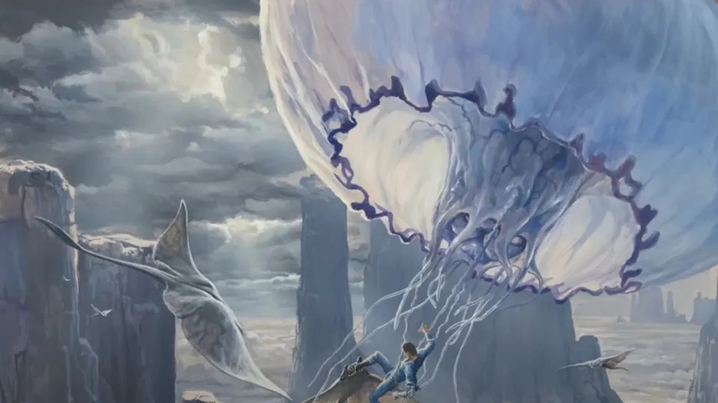

AVATAR 3
Format: Movie
Key Talent: Sam Worthington,
Zoe Saldana, Sigourney Weaver
Releasing Company: Lightstorm Entertainment
Release Date: December 19, 2025
Presented to you by
The “Deadpool” Team
Names & Responsibilities:
KJ-Slide Editor/Title Slide/Overview/Activation Calendar/Marketing Research
Devante-Owned Platform/content rec/Marketing strategy
Moises-Phased Marketing Strategy
Kavish-Earned & Paid Media/Talent Overview
KJ

Slide 2
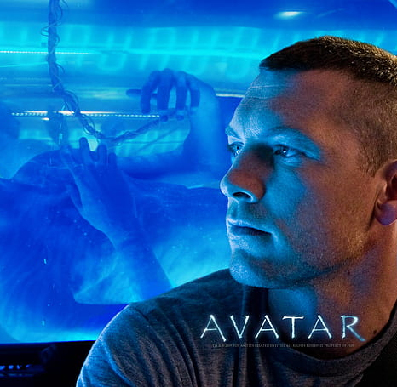




Overview
Logline: As the feud between Sully and Quadritch continue, Jake seeks refuge for his family while still aiming to put an end to the human adversaries continuing to hunt them due to their desire to acquire their planets resources without further conflict, while coming upon a tribe who does not share their compassion for harmony.
KJ

Slide 3
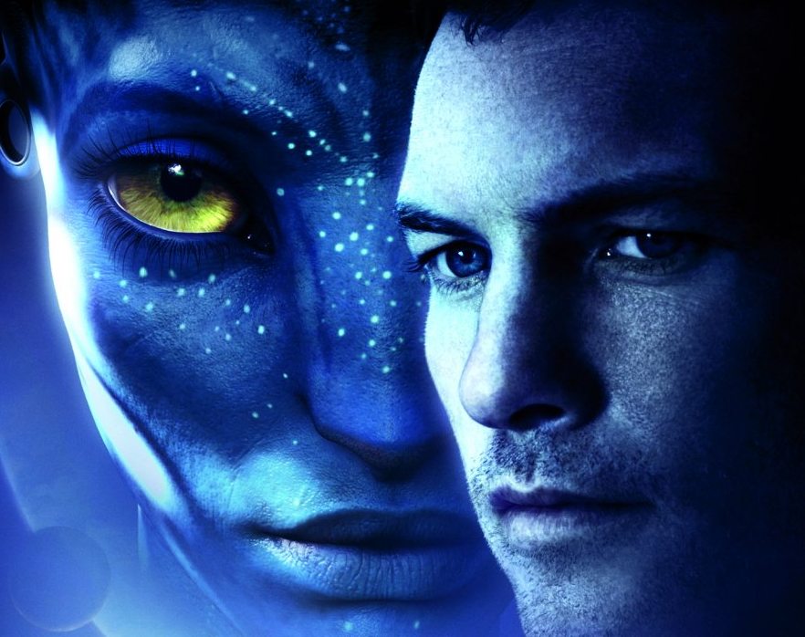
Overview
Key Themes:
-Love/Destiny/Purpose
Tone:
Human vs. Na’Vi
Na’Vi vs. Na’Vi
-Focus on invidivual characters
Target Audience: (Demographic/Pyschographic)
Adults, families, technology enthusiasts, teenagers, and especially ‘Hardcore: Science Fiction Fans’
Goes w/o saying---”current Avatar 1&2 fans”
KJ

Slide 4


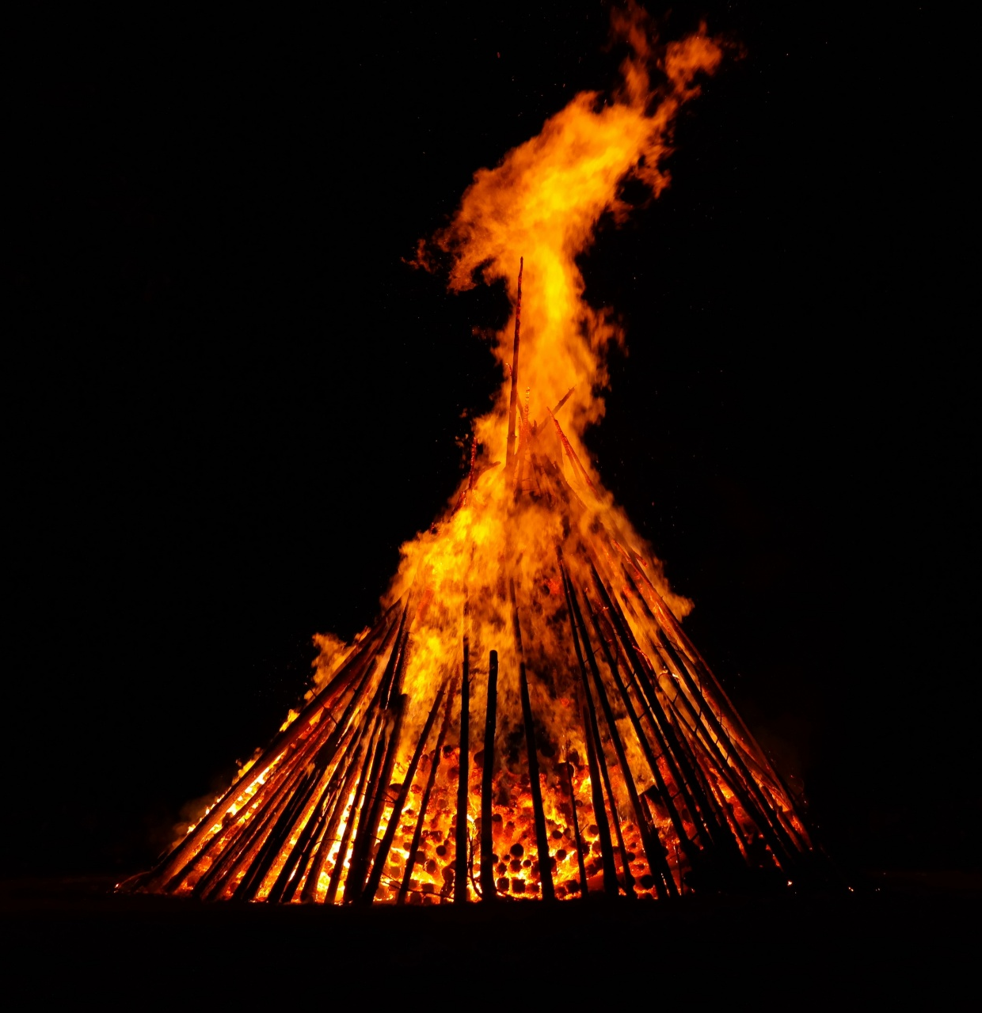
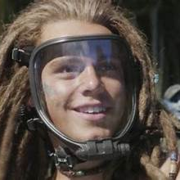
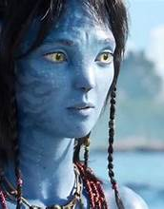
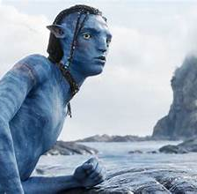
Overview
KJ
Key Messaging:
Character Development-particularly the kids
Narration done by second son, Lo’ak instead of Sully
-Not all Na’Vi tribes are good
-Vision of hope will be told through younger eyes

Slide 5
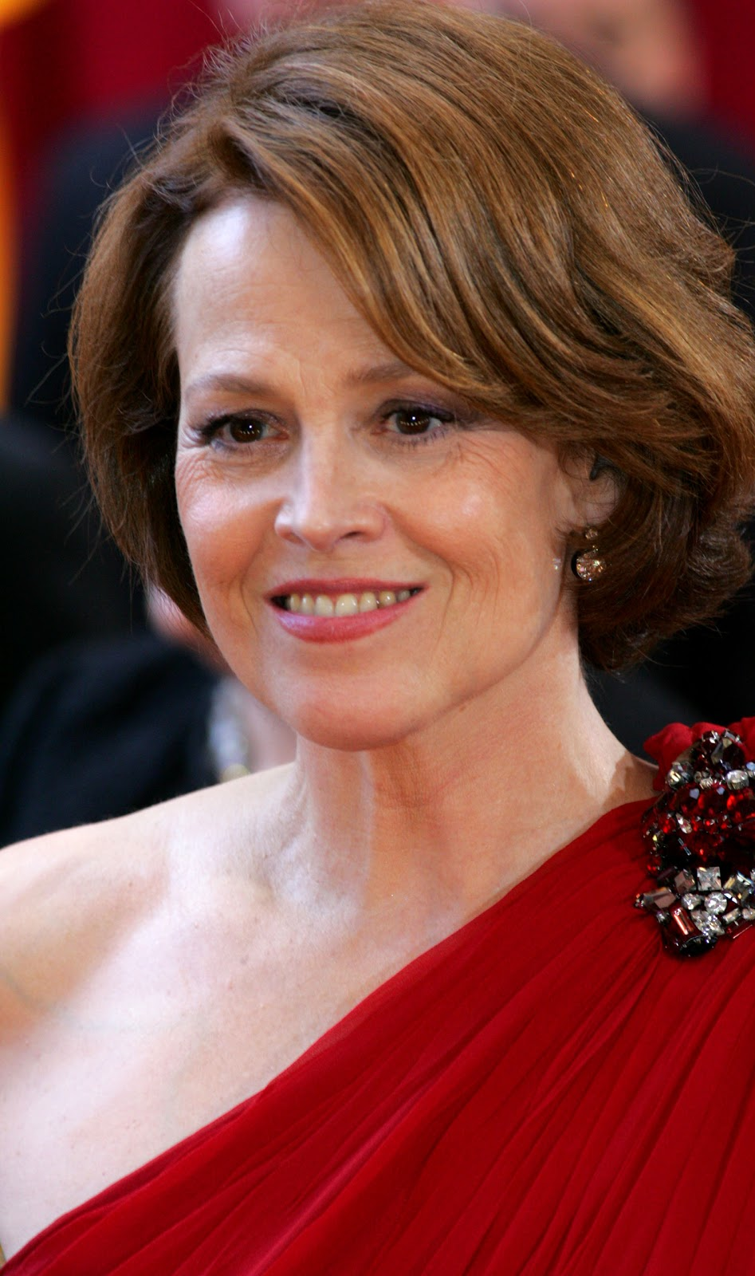

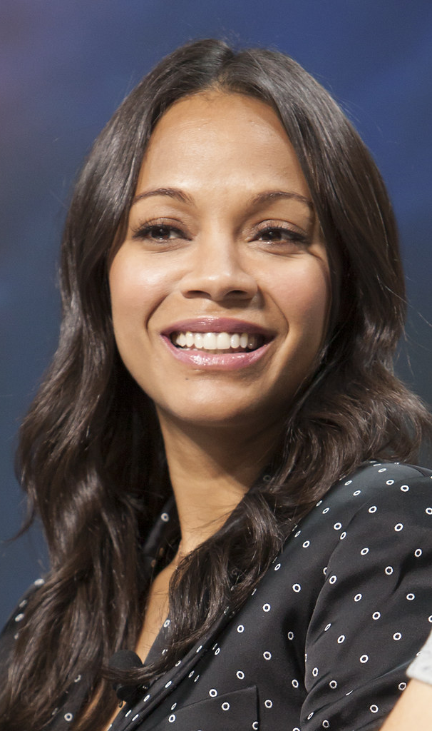
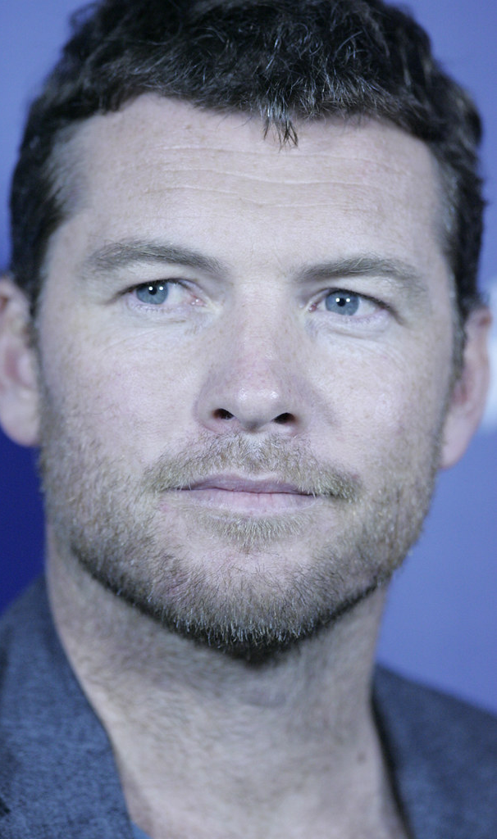
Talent Overview
KG
Zoe Saldana – Neytiri
Prior Work: Guardians of the Galaxy, Star Trek (2009)
Following: IG: 11.1M X: 1.2M FB: 5.6M
Sigourney Weaver - Dr Grace Austine
Prior Work: Alien, Avatar 1, Gorillas in the Mist
Following: No Social Media (only fan accounts)
Sam Worthington - Jake Sully
Prior Work: Terminator-Salvation, Clash of the Titans
Following: No Social Media (only fan accounts

Slide 6
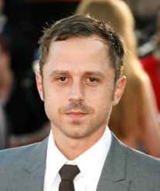
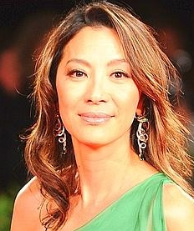

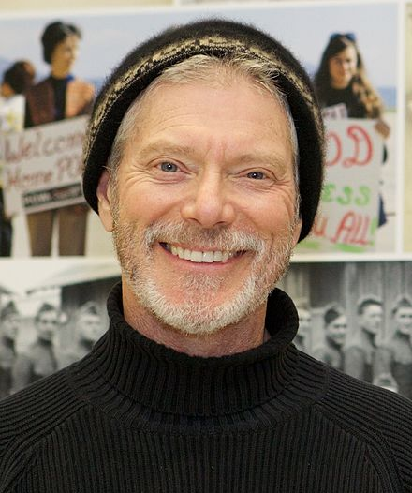
Talent Overview
Giovanni Ribisi – Selfridge
Prior Works - Boiler Room, The Gift, Sneaky Pete
Following: X: 24.3K (Not active on social media
*Far Left
Michelle Yeoh - Dr. Karina Mogue
Prior Work: Everything Everywhere all at Once, Crazy Rich Asians, Tomorrow Never Dies
Following: IG: 2.6M FB: 540k
*2nd from left
David Thewlis – Peylak
Prior Work : Naked, Harry Potter, Wonder Woman
Following: IG: 354K
*2nd from right
Stephen Lang - Miles Quaritch
Prior Work: Avatar, Don't Breathe, ManHunter
Following: IG: 103K X: 25.4K FB: 8.7K
*Far Right
KG

Slide 7
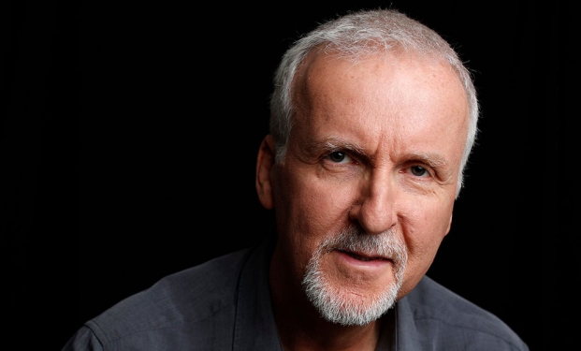
Talent Overview
Director/Writer - James Cameron
Prior Works: Aliens / Terminator / Avatar / True Lies
Following: IG: 652K X: 872.3K FB: 1.2M
OTHER BEHIND THE SCENES MEMBERS INCLUDE:
Writer - Rick Jaffa
Prior Works: Planet of the Apes franchise, Avatar way of water, Mulan
Following: X: 424 Followers
Writer - Amanda Silver
Prior Works: Planet of the Apes (franchise), Jurassic World, Fallen Angels
Following: X: 26.7K IG: 1K
KG

Slide 8

Marketing Research
Six reasons for success
-Cast
-Story/Plot
-CGI
-Immersion
-The soundtrack
-The Cinematography
KJ

Slide 9
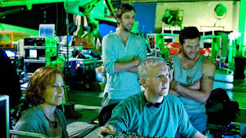
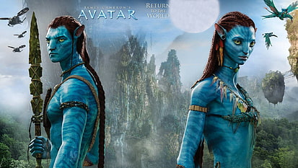
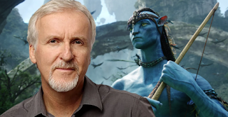
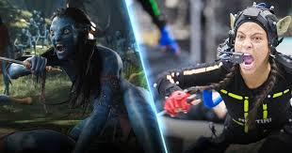
Marketing Research
GREAT TALENT BUILDS THE STORY AND HELPS CUSTOMERS DIVE INTO PLOT
CHOOSE BELIEVABLE CHARACTERS W/ STRONG ARCS
-REFERENCE PAST SUCCESS/BUILD ON GROWTH/MARKET THE SAME
KJ

Slide 10
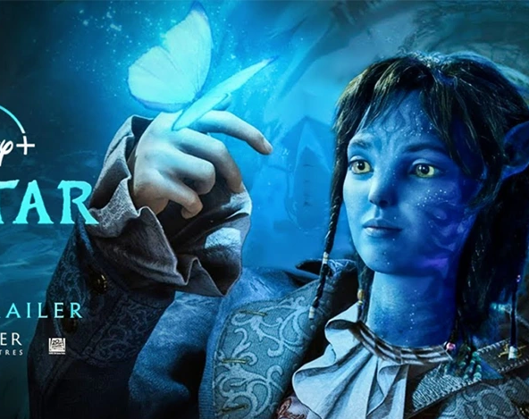
Phased Marketing Strategy
MM
Phase 1:
Tease Dates: Several months before release
Beat Messaging: "Discover Pandora," "Unleash Your Imagination"
Key Activations: Social media teasers
Phase 2:
Coming Soon Dates: A few months before release
Beat Messaging: "Prepare for the Adventure," "Coming Soon to Theaters Near You"
Key Activations: Release of official teaser trailer
_______________________________________
Phase 3:
Pre-Launch Dates: Weeks before release
Beat Messaging: "Join the Journey," "Experience Pandora Like Never Before"
Key Activations: Release of full-length trailers

Slide 11
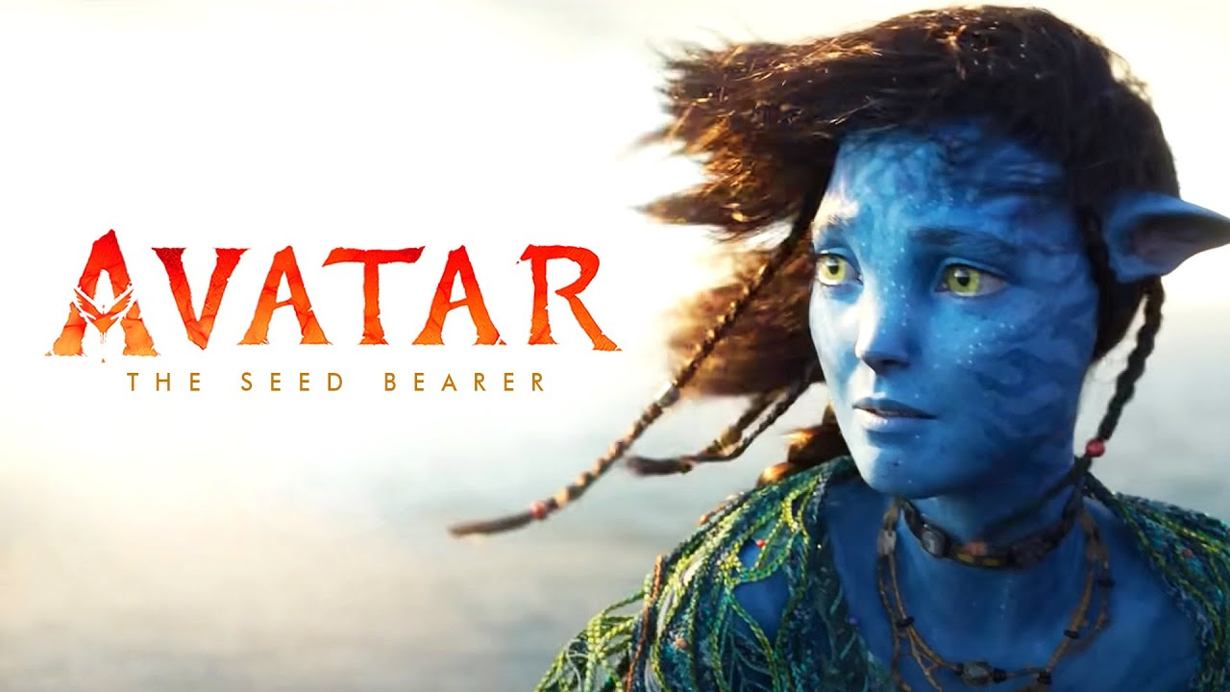
Phased Marketing Strategy
MM
Phase 6:
Post-Premiere Dates: After release
Beat Messaging: "Join the Convo”, "Share Your Experience"
Key Activations: Social media buzz
_________________________________________________
Phase 7: Sustain Dates: Weeks to months after release
Beat Messaging: "Keep the Adventure Alive,"
"Discover Pandora Again and Again"
Key Activations: Extended theatrical run
Phase 4:
Countdown Dates: Days before release
Beat Messaging: "Countdown to Pandora," "The Wait Is Almost Over"
Key Activations: Social media countdowns
_____________________________________________________
Phase 5:
Premiere Dates: Release day
Beat Messaging: "Experience the Spectacle," "Journey to Pandora Begins Today"
Key Activations: Red carpet premieres

Slide 12

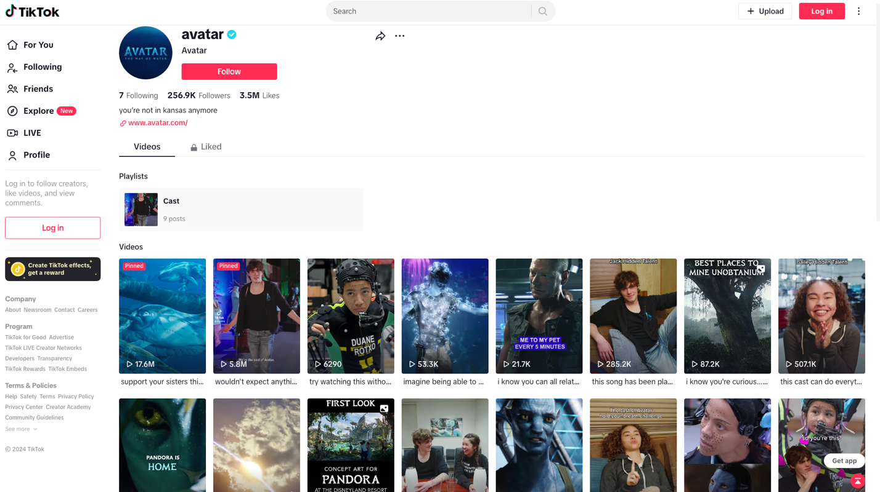
Owned Platform/Content Rec’s
DG
TikTok: 256.9K Followers

Slide 13

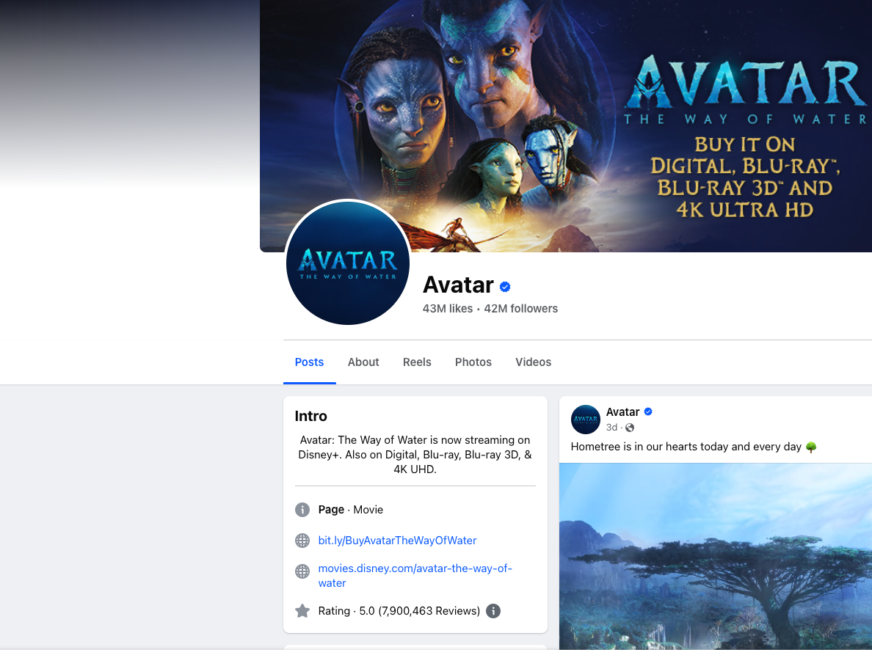
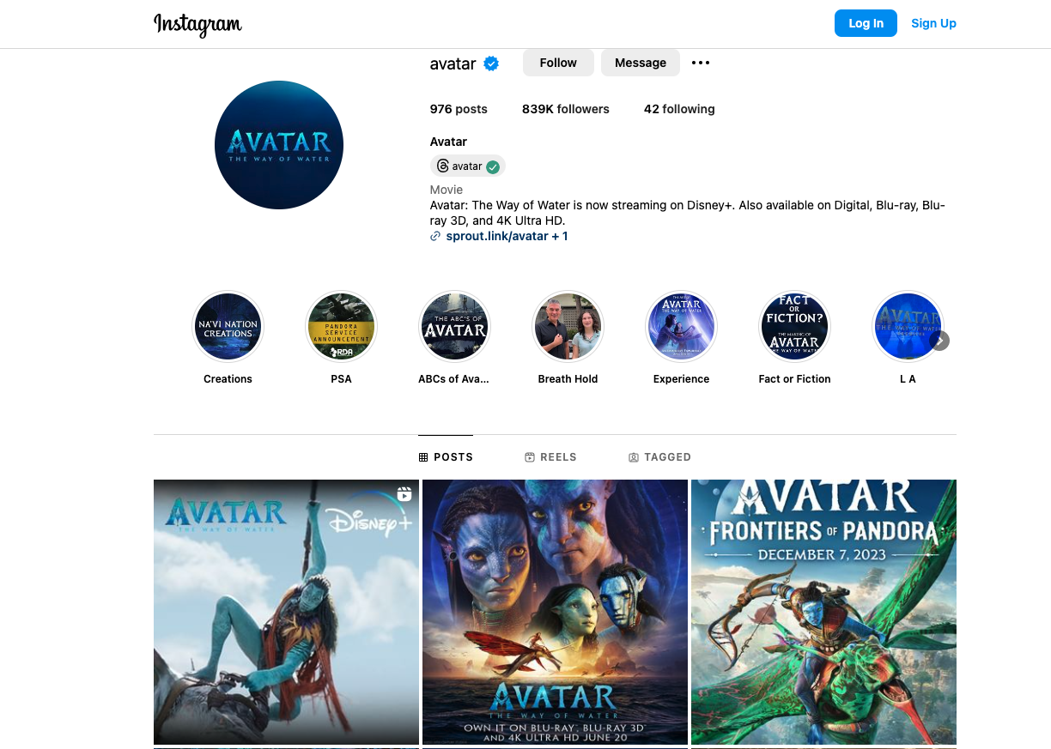
Owned Platform
/Content Rec’s
Facebook: 42 million followers and over 43 million likes
Instagram: 839K followers with over 976 posts
Relied on…
Social Media, Merchandise, Special Effects, and 3-D technology to cause buzz
DG

Slide 14
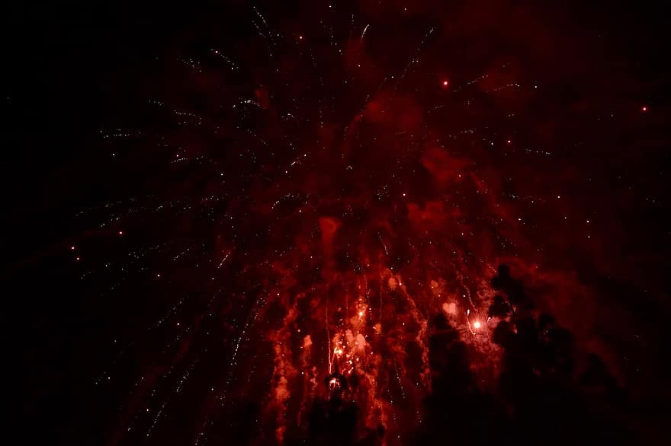
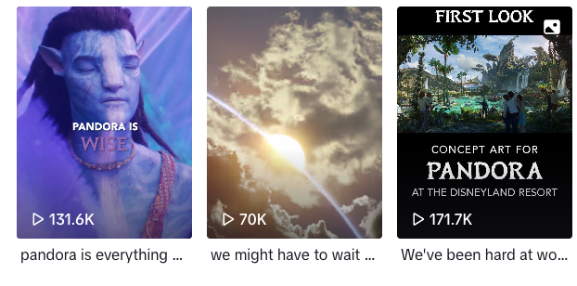
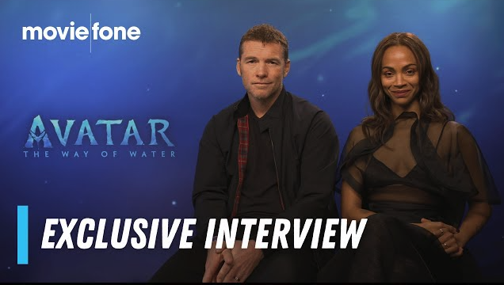
Owned Platform/Owned Rec’s
DG
TikTok, Facebook and IG: Photos, reels, stories, videos, live feeds
This will showcase many aspects of our film: teasers, posters, reviews, interviews, trailers, and a countdown to build anticipation.
Strategy-

Slide 15
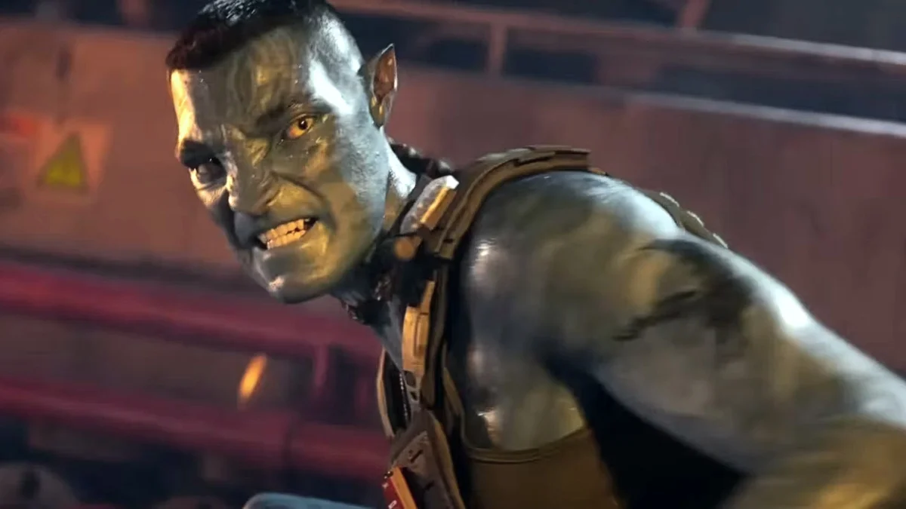
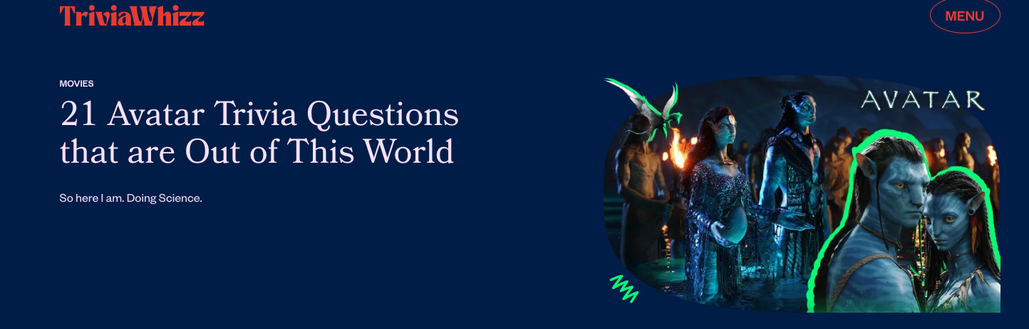
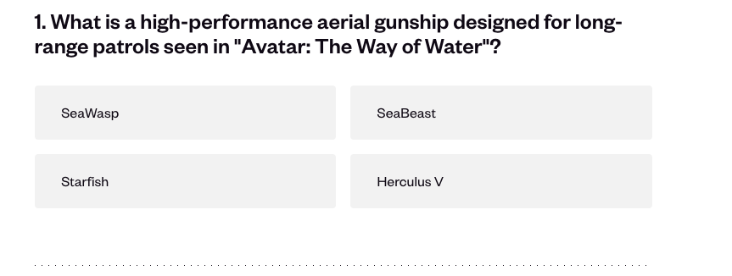
Owned Platform/Owned Rec’s
Creative Content Concepts (Tiktok/FB/IG)
We plan to create a fun and interactive experience for the viewer.
Quizzes and Avatar trivia
In-person and virtual Q&As with executives
Brand giveaways, offering followers prizes by liking, and sharing our content.
DG

Slide 16
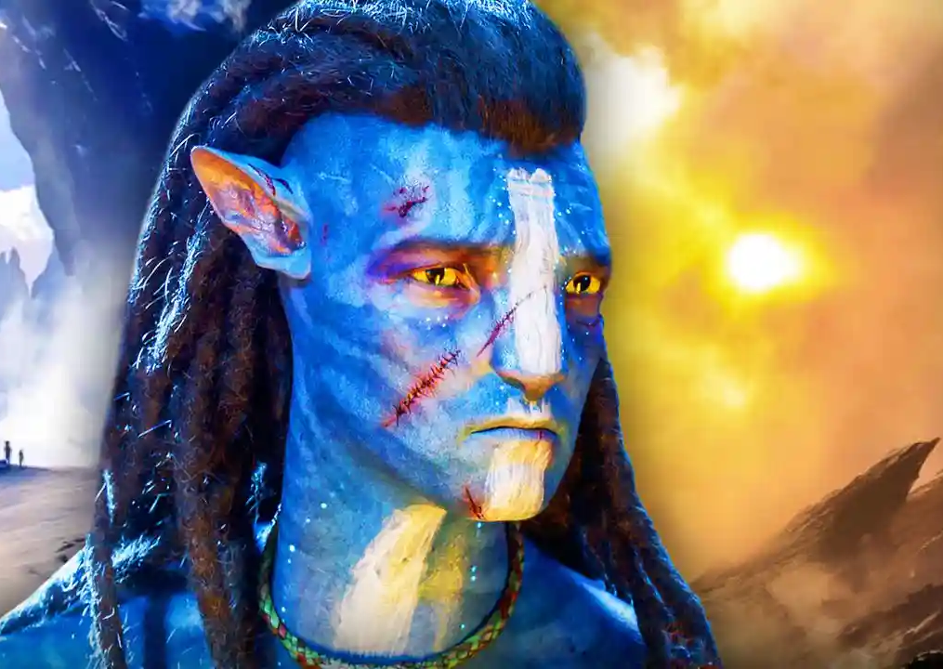
Earned & Paid Media Rec’s
KG
Digital PR:
-Good reviews from actors/actresses
-Influencer/Publisher Release event
-Invite lots of media to cover

Slide 17
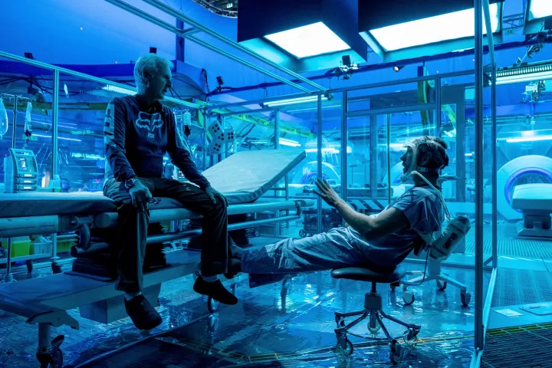
Earned & Paid Media Rec’s
KG
Paid Advertising:
-Get influencers to create campaigns
-Keep their followers updated on events and premieres
-Run TV ads-for younger generations
-run ads on tv shows
-sports broadcasts
-HBO/TNT/FXNOW

Slide 18
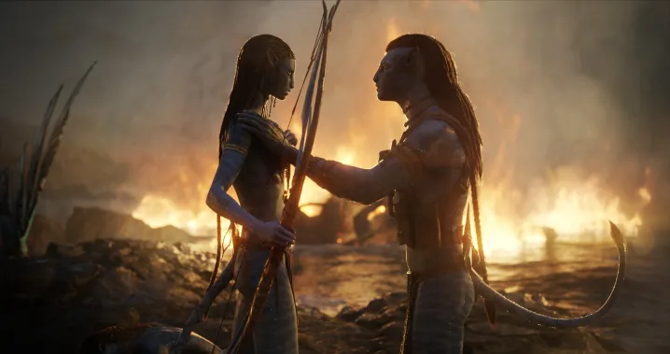
Earned & Paid Media Rec’s
Out of Box Promotions!!!!
-Billboards
-Host Q&A w/ main cast
-Create themed rides at parks
KG

Slide 19

Activation Calendar
Dec-2024-James Cameron Interview (his general plan)/filming wrap-up announcement
June-2025-teaser trailer/character interviews/behind-the scenes content
September-2025-release of trailer/promotional merchandise/in-depth Cameron interview
October-2025-Promotional signing at Halloween/Costume film Festival
November-2025-Pre-launch/full length trailers/toy company partnerships/DL Visitations
December 2025- Countdown posters around NYC/CA/NV/Premiere showings
Jan-Mar 2025-Post premiere/after release/sustain/frequent re-cap interviews w/ casts
In short-keep people intrigued w/ mystery leading into it
Keep them wanting more as it gets closer
Keep them coming back to theaters w/ friends
This Photo by Unknown Author is licensed under CC BY-NC

Slide 20
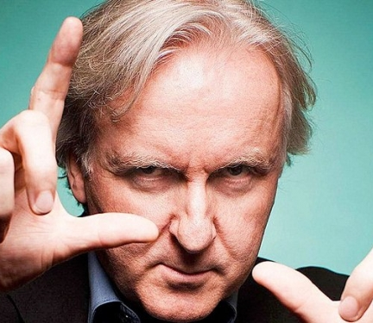

THANK YOU

